Slide 1

DESCON
ARCHITECTS &PROJECT MANGEMENT CONSULTANCY SERVICE

Slide 2

About Us
We assist organizations in doing the right projects—those with strategic alignment that make the best use of your time, talent, and budget—and doing them right.
Architecture &Project management consultancy services are vital for high impact, time sensitive projects—those most critical to your Project’s success.

Slide 3

Our Service
ARCHITECTURAL
INTERIOR
MEP
LANDSCAPING
PROJECT BUGETING
PROJECT SCHEDULEING
CRISIS MANGEMENT
PROJECT CONTROL
Architecture &Project management consultancy services are vital for high impact, time sensitive projects—those most critical to your Project’s success.

Slide 4

Ramesh Selvam . MSR . B.E., F.I.E,
Chief Executive Officer Mobile: +91 9176199099
Civil engineer with more than thirty five years of experience in Design and Management, specializing in Hospital and Commercial ventures.
Excellent command of standard engineering practices with strict quality control.
Wide ranging exposure from individual homes to large scale construction projects including Shopping malls & Hospitals

Slide 5

Expertise in Surveying, Budgeting, Planning, Designing, Estimation, Scheduling, Value engineering, Cost control, Tender preparation & floating, managing construction permits and contractors, Planning, Monitoring and control of contractors and Vendors & End to End Project Management including Design proof review
AREA IN EXPERTISE

Slide 6
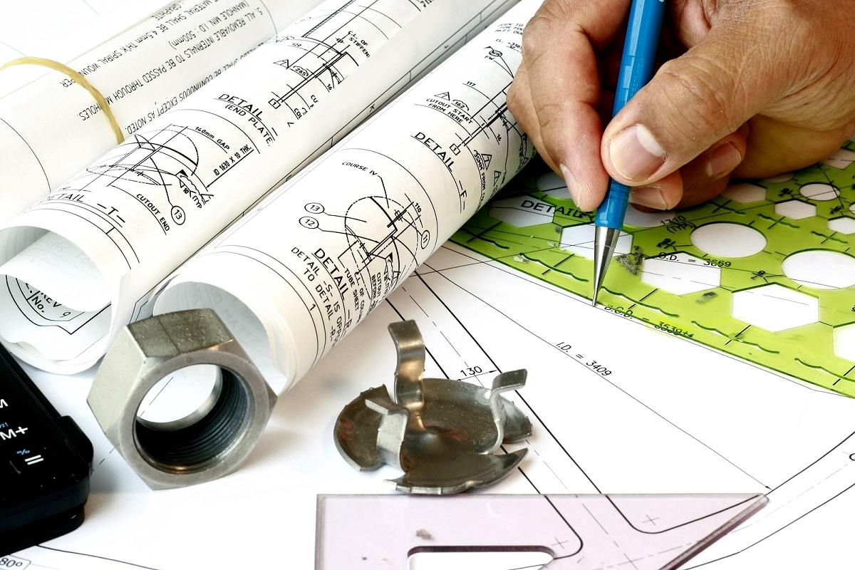
Expertise in all aspects of Construction Management EPC (Engineering, Procurement Construction, Survey, Site Supervision) SCM (Supply Chain Management - material and labour resource optimization), Quality Plan – assurance and Control safety plan – Health and Environment Compliance. Testing, Transition Management till commissioning and after commissioning.
AREA IN EXPERTISE

Slide 7

Expertise in handling cross functional stakeholders – staff, contractors, clients, government authorities, CXOs Overseas experience in Guam islands for Sumitomo Constructions – Resorts, Golf course bridges and roads
AREA IN EXPERTISE

Slide 8

CHIEF EXECUTIVE OFFICER DESCON, CHENNAI. Apr-2011 Onwards St. Isabel’s Hospital, Chennai - Development of Radiology & Cardiology Department - Renovation of Emergency Department - Renovation of OP department Independent Bungalows. Villas , Apartments in Chennai, Coimbatore & Madurai - Project Management Consultancy
PROFESSIONAL EXPERIENCE

Slide 9
GENRAL MANAGER -Projects ARCHIMEDES I NDIA ASSOCIATES, CHENNAI. Oct-2014– Mar 2021 GENERAL MANAGER M/S.HARINARAYANA BUILDERS Apr 13 – Dec 14 PROJECT HEAD M/S.CALADIUM PROPERTIES Jun-12 – Mar 13
PROFESSIONAL EXPERIENCE

Slide 10
PROJECT COORDINATOR SAKTHIVEL ASSOCIATES; Chennai, Tamil Nadu India. Jun 2011 – May 2012 PROJECTS & OPERATIONS –H EAD AMPA HOUSING DEVELOPMENT PRIVATE LIMITED Chennai, Tamil Nadu India Dec 2004 – March 2011 Engineer-in-Charge - Project Management APOLLO HOSPITALS ENTERPRISE LIMITED, Projects and Consultancy Division, New Delhi, India Nov 2001 – Nov 2004
PROFESSIONAL EXPERIENCE

Slide 11
Senior Projects-in-charge HARI NARAYANAN STRUCTURALS - Chennai, Tamil Nadu India Apr 1996 – Nov 2001 Senior Engineer R.S ASSOCIATES - Chennai, Tamil Nadu India Feb 1993 – Mar 1996 Site Supervisor – Leo Palace Resorts SUMITOMO CONSTRUCTION CO. LTD., Guam, U.S.A Aug 1991 – Jan 1993
PROFESSIONAL EXPERIENCE

Slide 12
Project Engineer TECHNICALAYA CONSULTANTS (P) LTD., Chennai, Tamil Nadu India Dec 1989 – Aug 1991 ARCHITECTURAL INCHARGE KP ASSOCIATES., Chennai, Tamil Nadu India Aug 1985 – Nov 1989
PROFESSIONAL EXPERIENCE

Slide 13
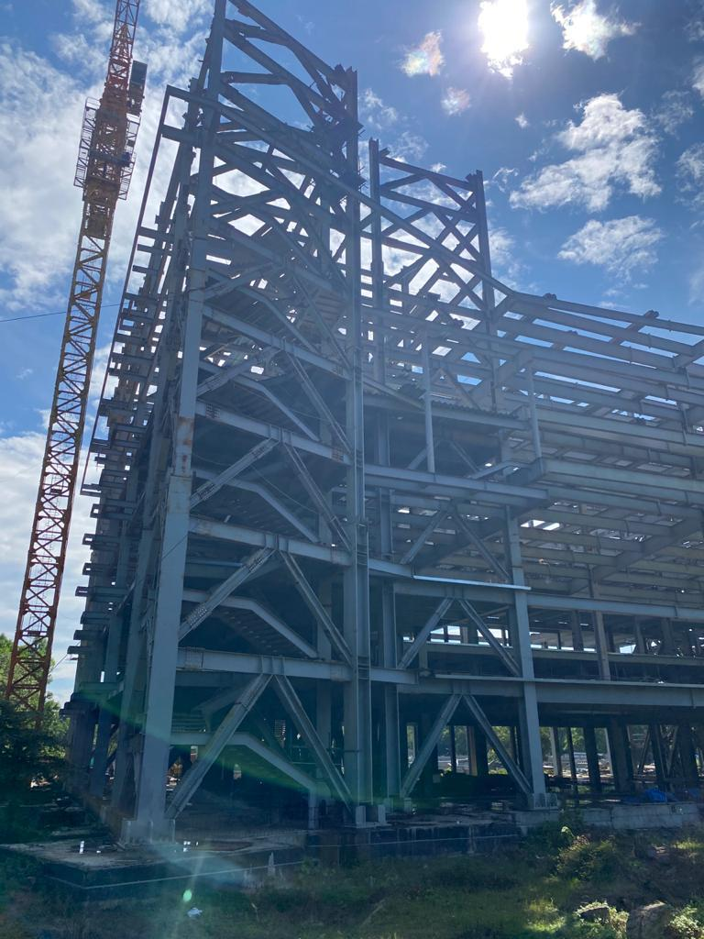
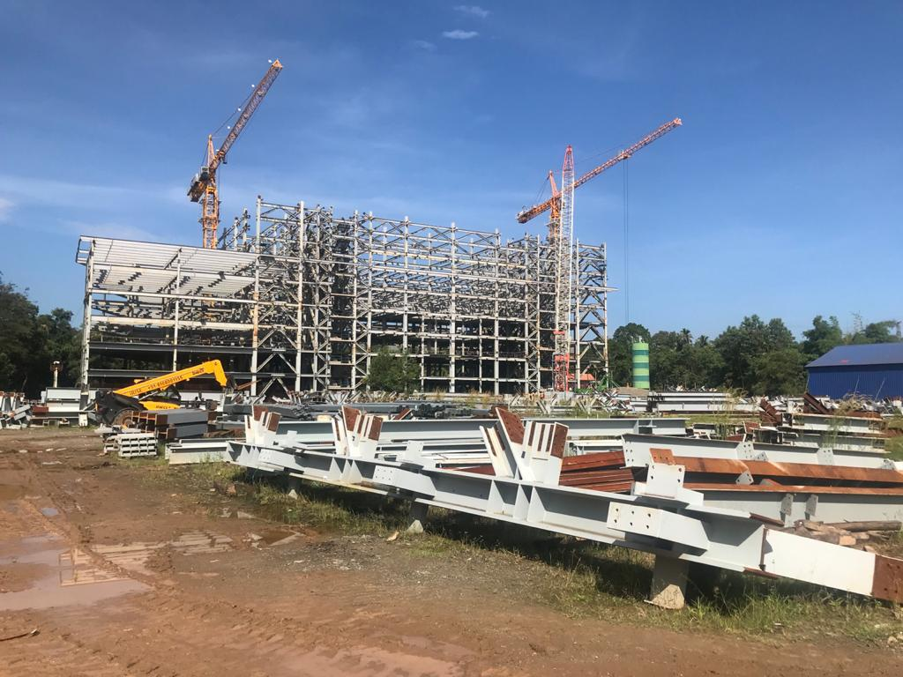
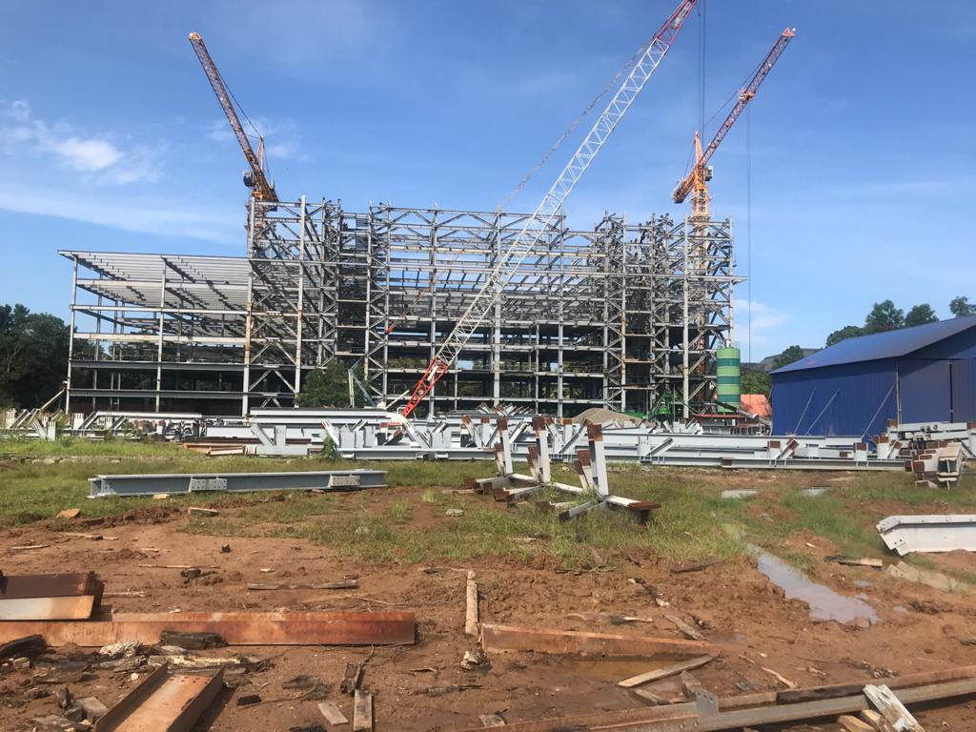
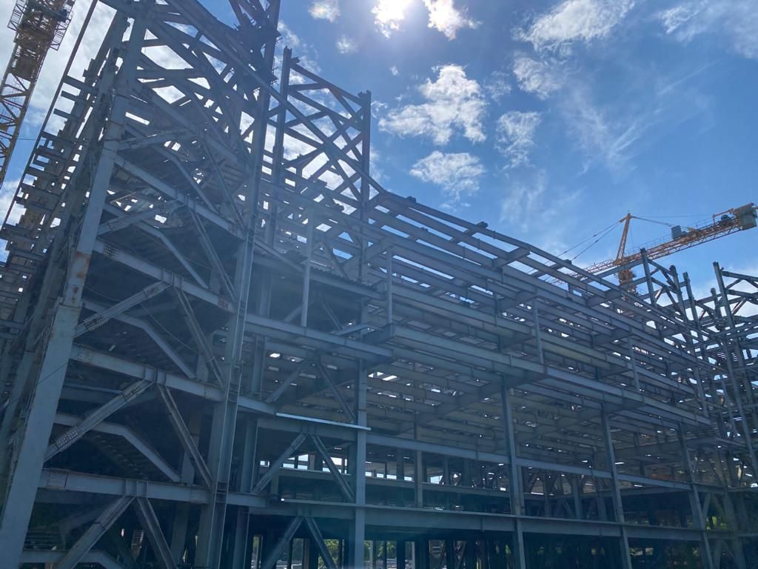
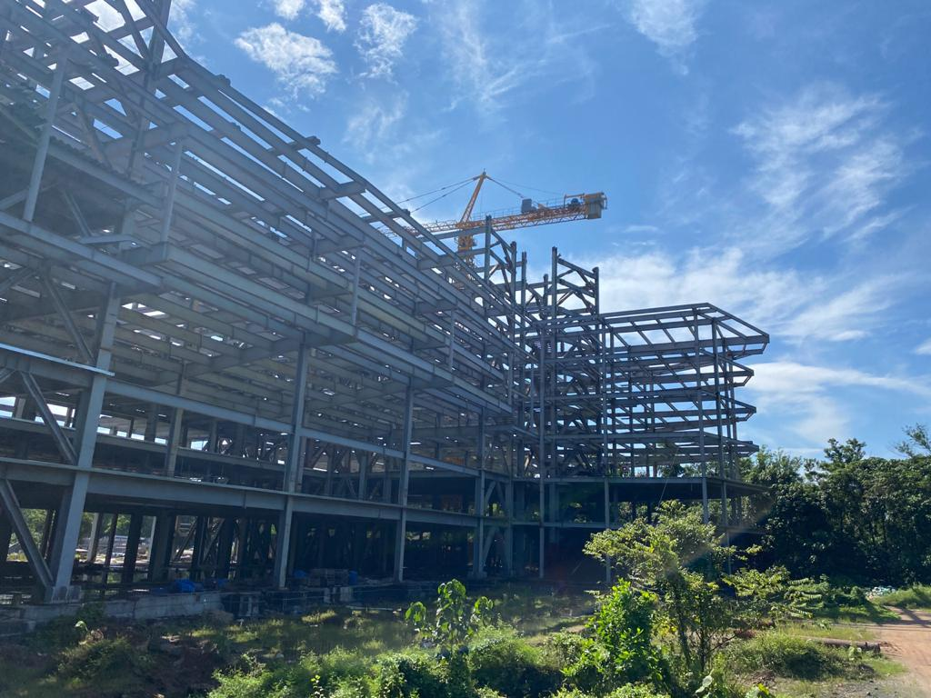
PROFESSIONAL EXPERIENCE

Slide 14

Kavitha.M. B.Arch
CHIEF ARCHITECT Mobile: +91 9620739939
With (17) Seventeen years of experience in field of architectural design, I have exceptional skills and experience in planning designing, detailing and coordination of projects both in major and minor projects.

Slide 15
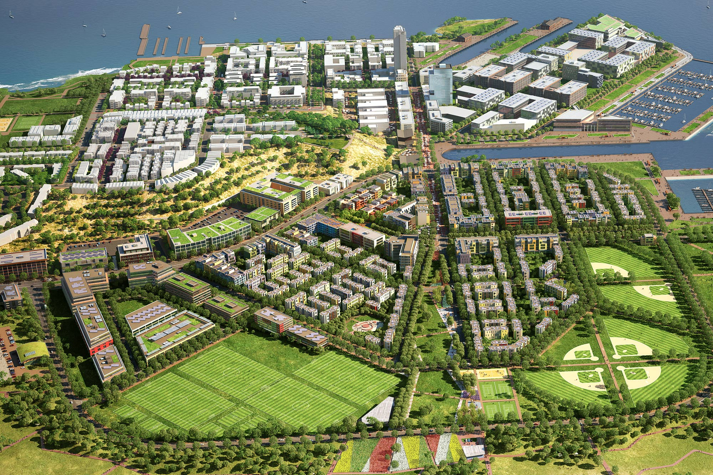
with experience in the planning , design and construction of diverse project renovation ,major and minor architectural projects such as institutional, recreational, healthcare facilities and residential
AREA IN EXPERTISE

Slide 16
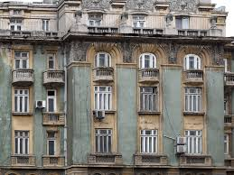
Extensive back ground in all infrastructures directing all project phrases from designs through completion of constructions, coordinating the efforts of contractors and engineering services consultants and all governments’ agencies.
AREA IN EXPERTISE

Slide 17

•As Architect in TECHINCALIYA CONSULTANTS PVT, LTD, CHENNAI. (SEPT 2004-OCT2009). •As Architect in ARCHIMEDES INDIA PVT, LTD, BANGALORE.(NOV 2010-FEB 2012). •As Senior Architect in THE BHARGAV GROUP PVT, LTD, CHENNAI.(MAR 2012- OCT-2013). •As External design Architect in THE BHARGAV GROUP PVT LTD,CHENNAI. (OCT2013-JAN 2014). •As Senior Architect & Team leader in ARCHIMEDES INDIA ASSIOCIATES,BANGALORE &CHENNAI (AUG2015-AUG2019).
PROFESSIONAL EXPERIENCE

Slide 18

•St. ISABEL’S HOSPITAL AT CHENNAI, TAMIL NADU •BABY MEMORIAL HOSPITAL AT CAILCUT, KERALA •HEDGE INSTITUTE OF MEDICAL SCIENCES & HOSPITAL AT CHICMAGULAUR, KARNATAKA. •HARIPAD MEDICAL COLLEGE &HOSPITAL AT KERALA. •Dr RELA INSTITUDE OF MEDICAL SCIENCES HOSPITAL AY CHENNAI TAMILNADU . •SINGARAM’S RESIDENCE AT CHENNAI . •GVN HOSPITAL,TRICHY,TAMILNADU. •CHENNAI MEDICAL COLLEGE &HOSPITAL AT TRICHY TAMIL NADU. •VELAMMAL MEDICAL COLLEGE &HOSPITAL AT MADURAI TAMIL NADU. •Dr.SUNDARASEN MULTISPECIATILY HOSPITAL AT AVADI, CHENNAI. •SRM UNIVERSITY ADMINSTRATION OFFICE AT POTHERI, CHENNAI . •BARAPET MEDICAL COLLEGE &HOSPITAL AT GUWAHATI ASSAM. •SRI VENKATESWARA MEDICAL COLLEGE &HOSPITAL AT PONDICHERRY. •SARASAWATHI INSITITUTE OF MEDICAL SCIENCES & HOSPITAL AT HARPUR, DELHI.
PROFESSIONAL EXPERIENCE

Slide 19
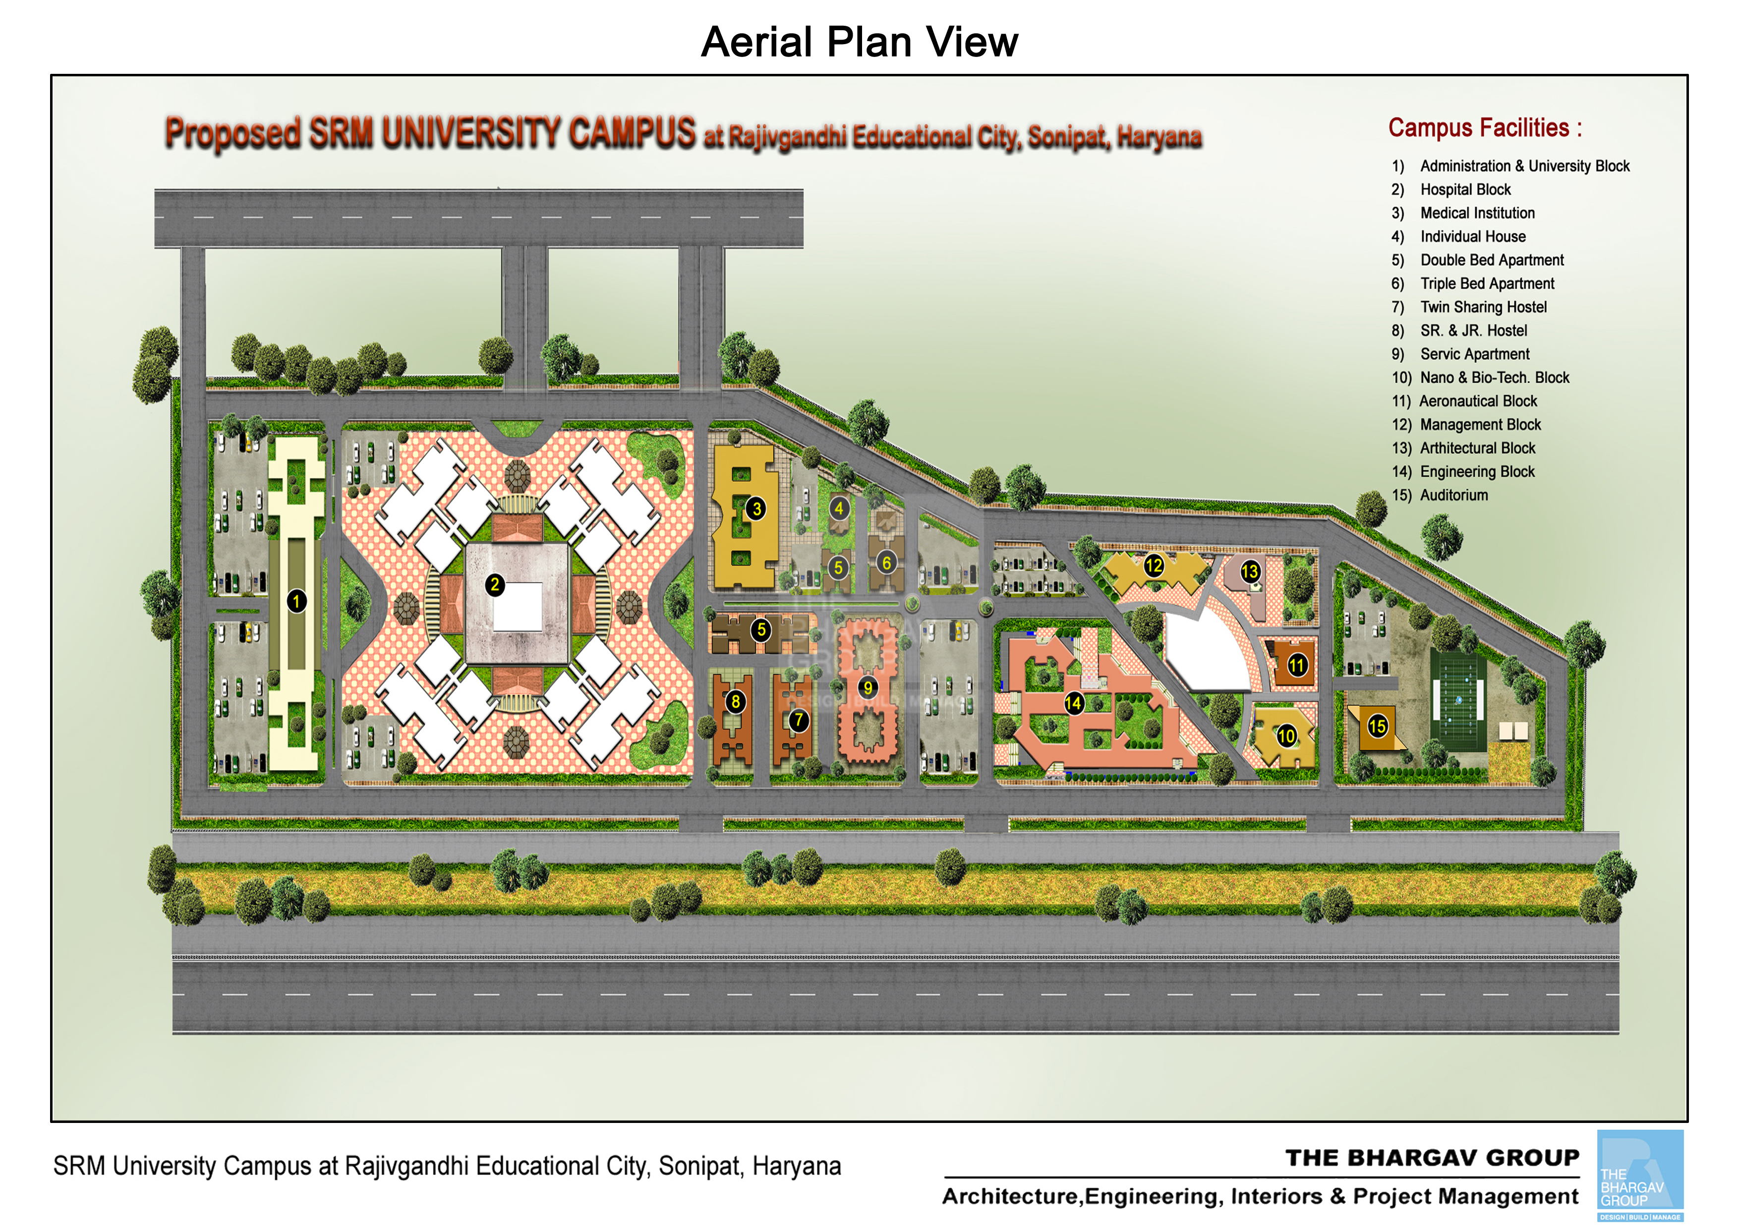
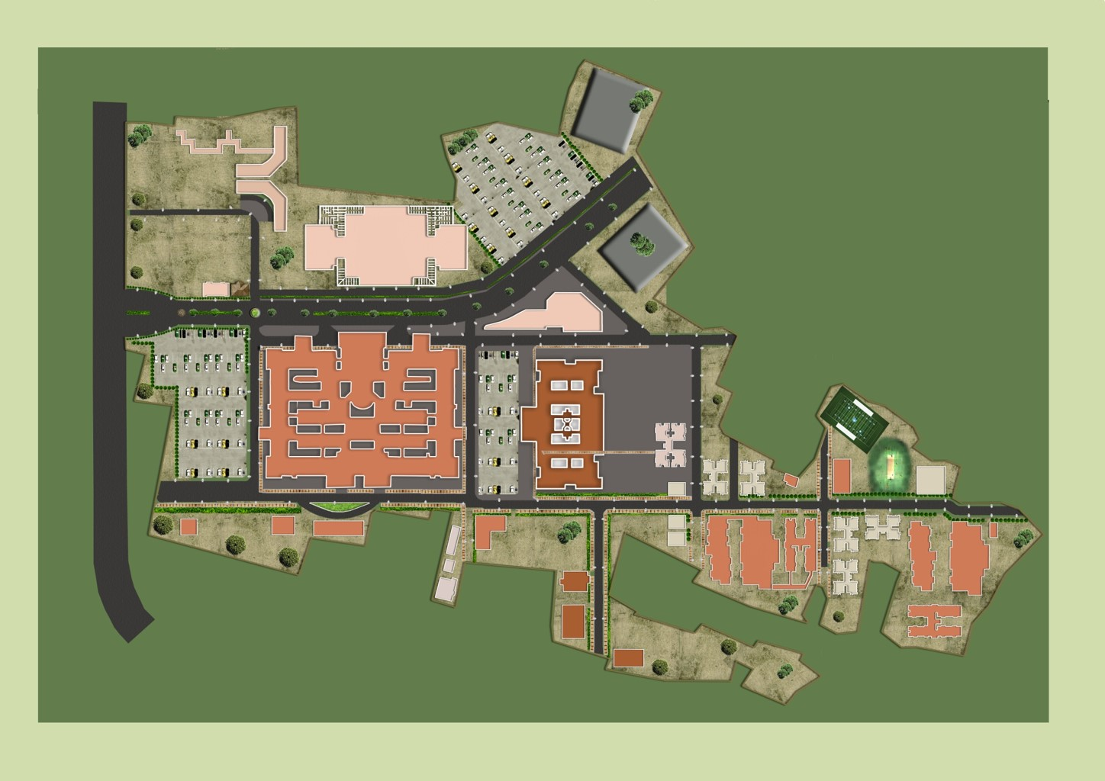
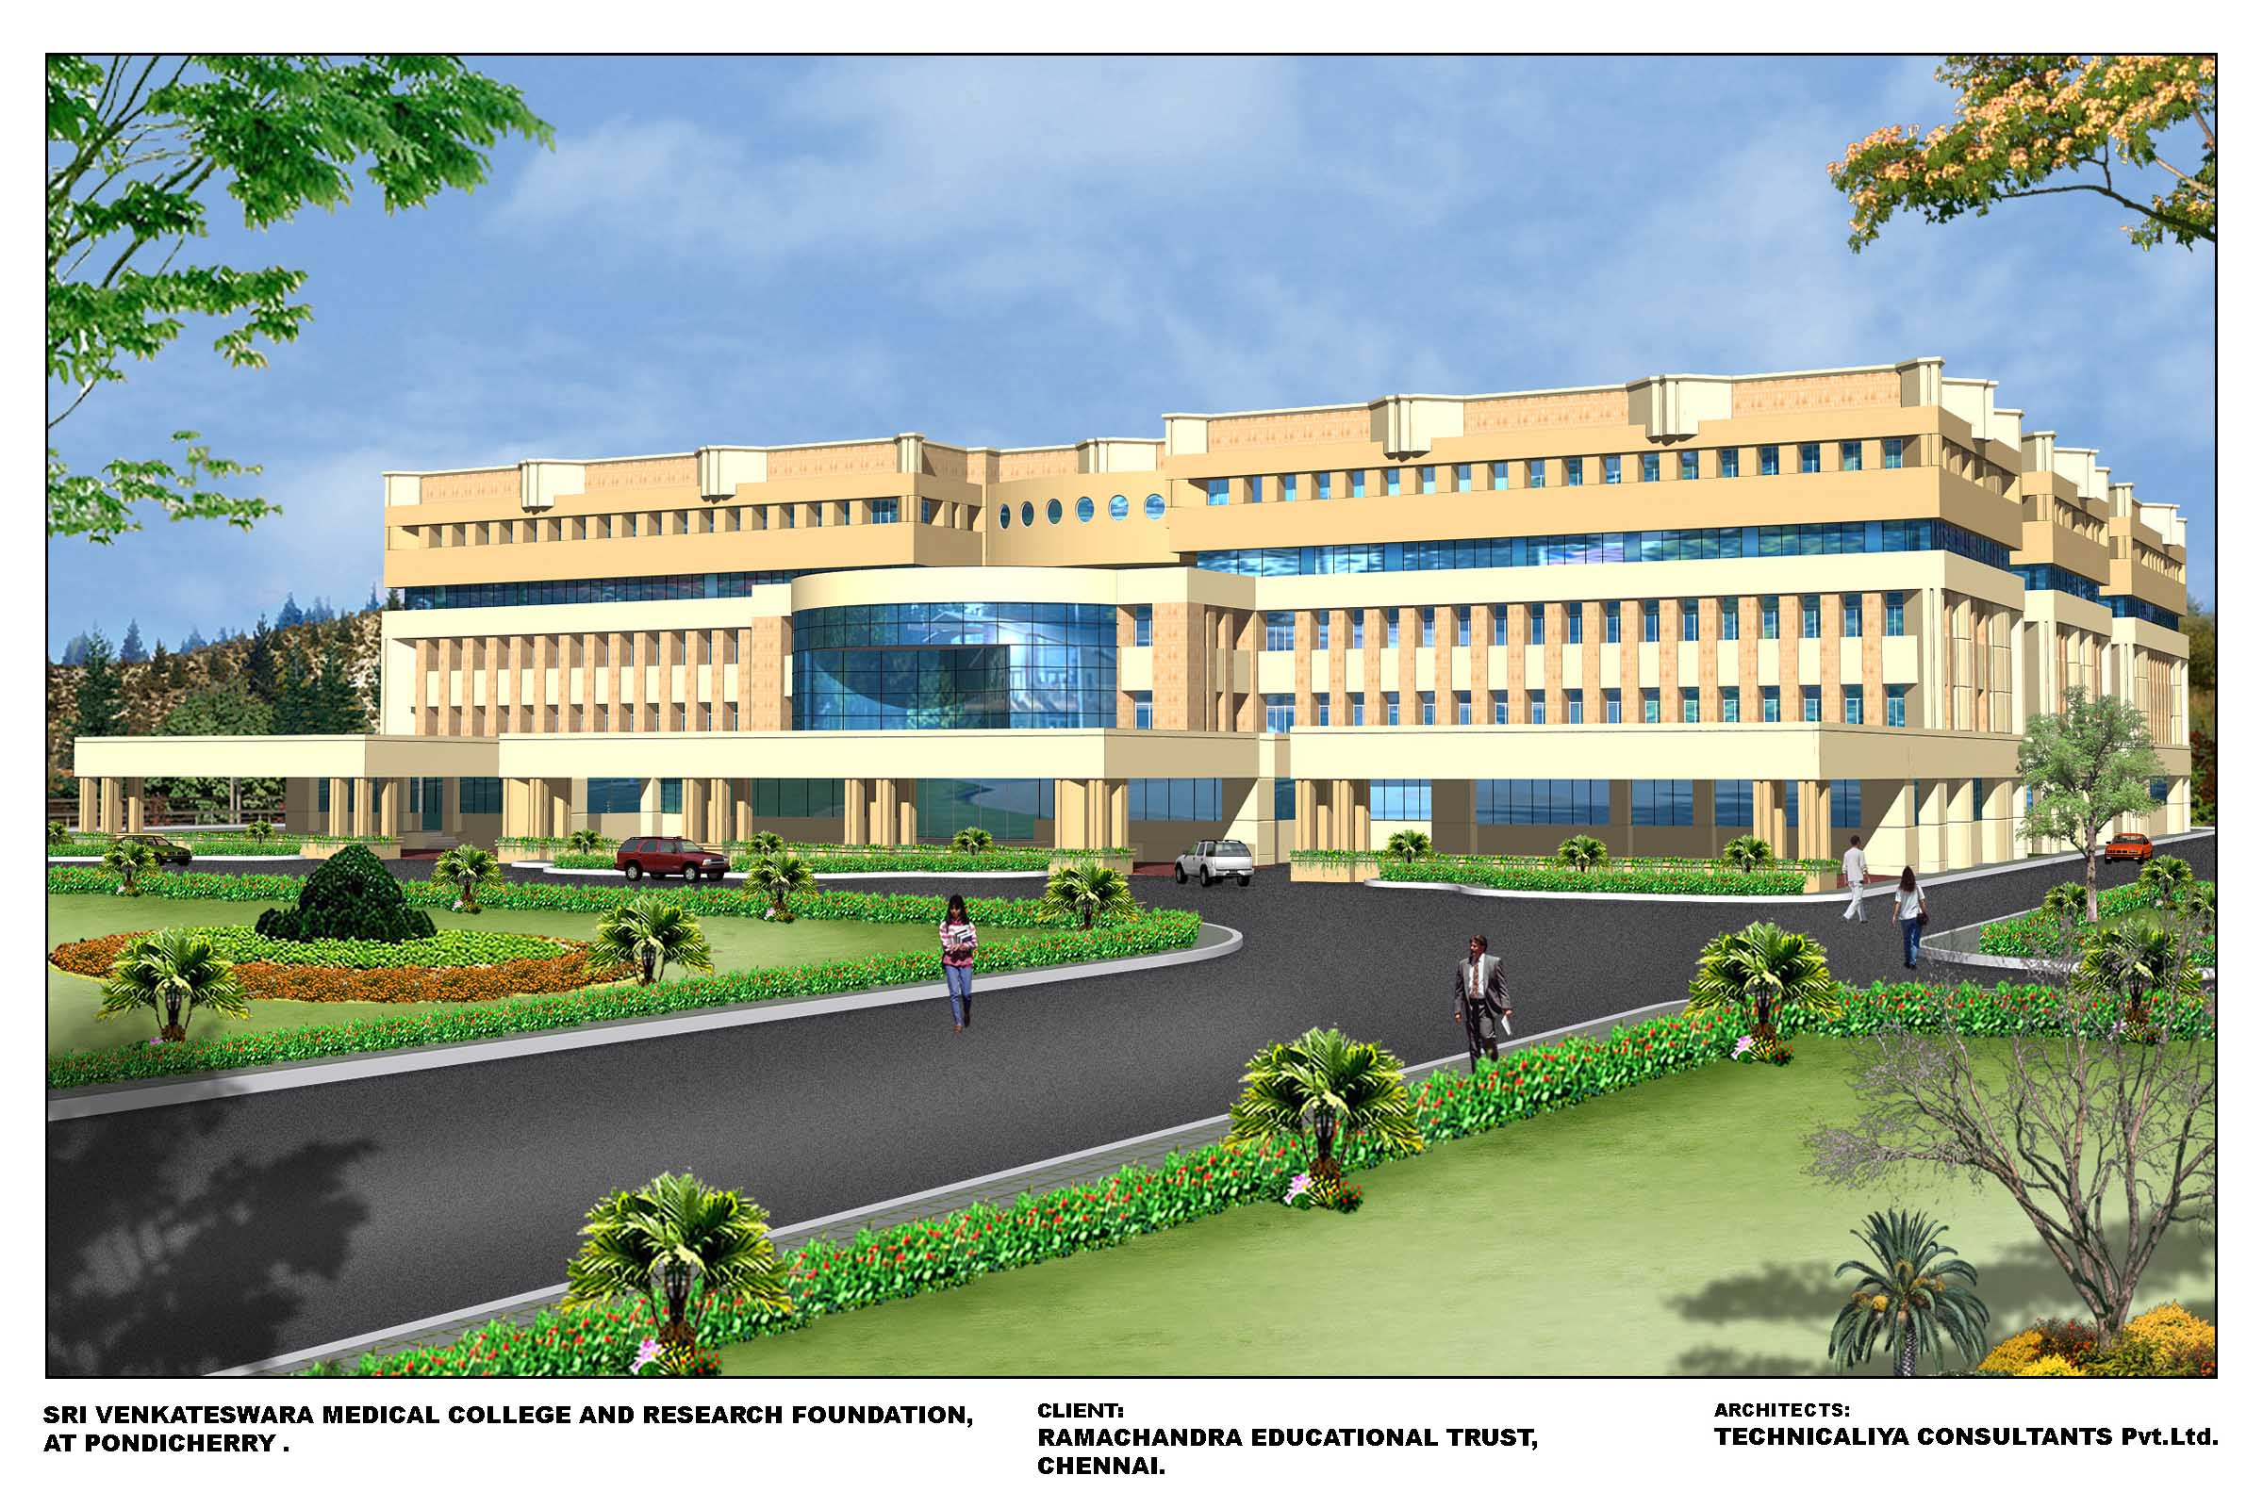
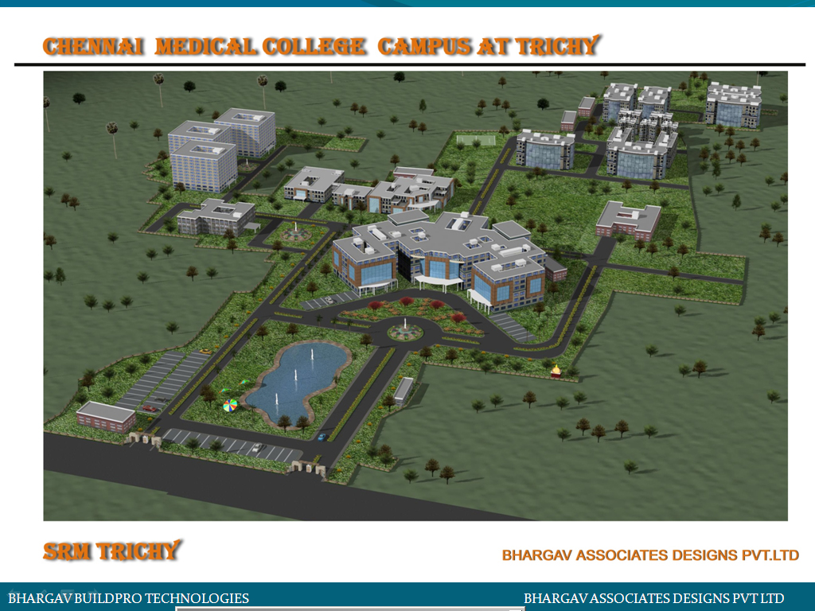
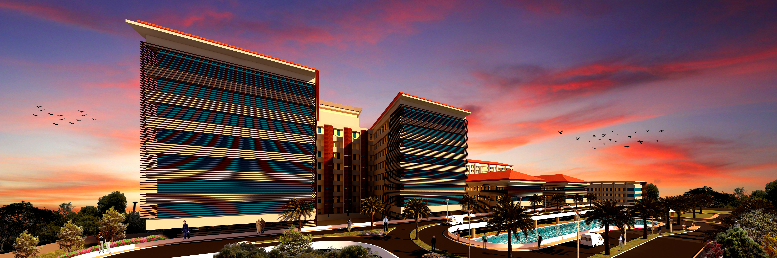
PROFESSIONAL EXPERIENCE

Slide 20
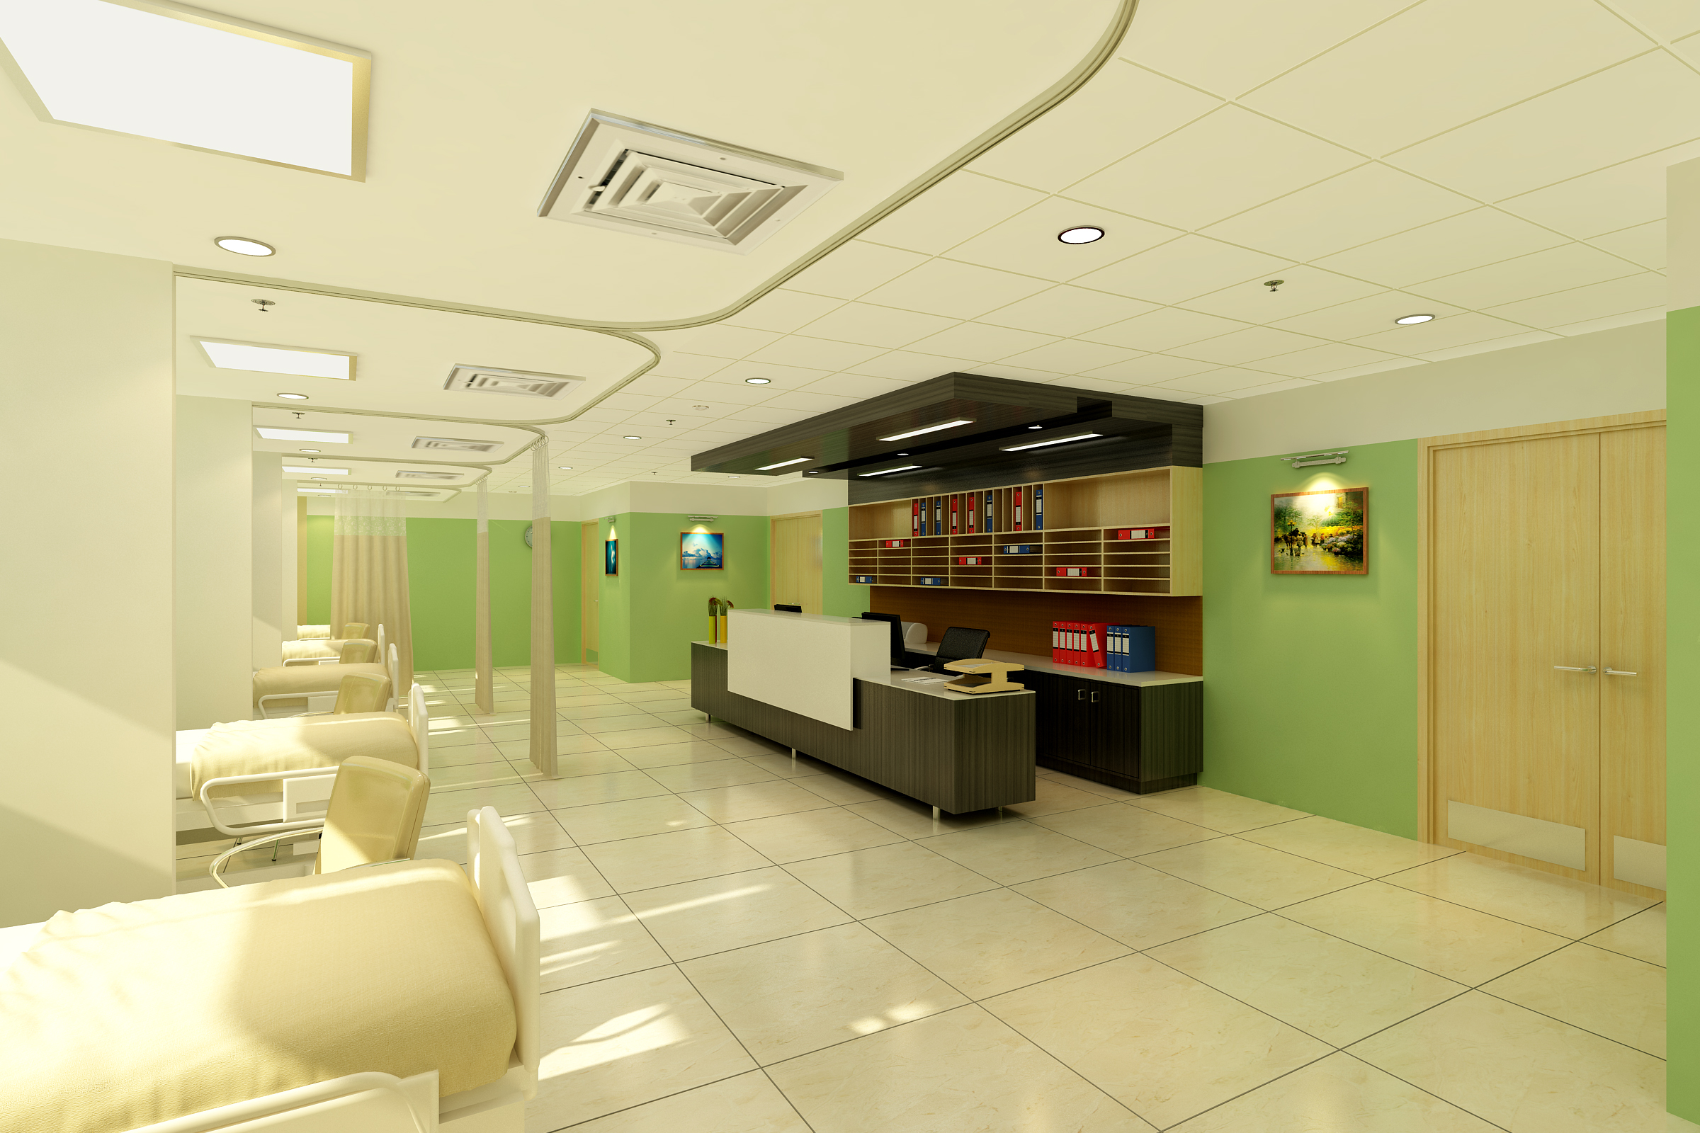
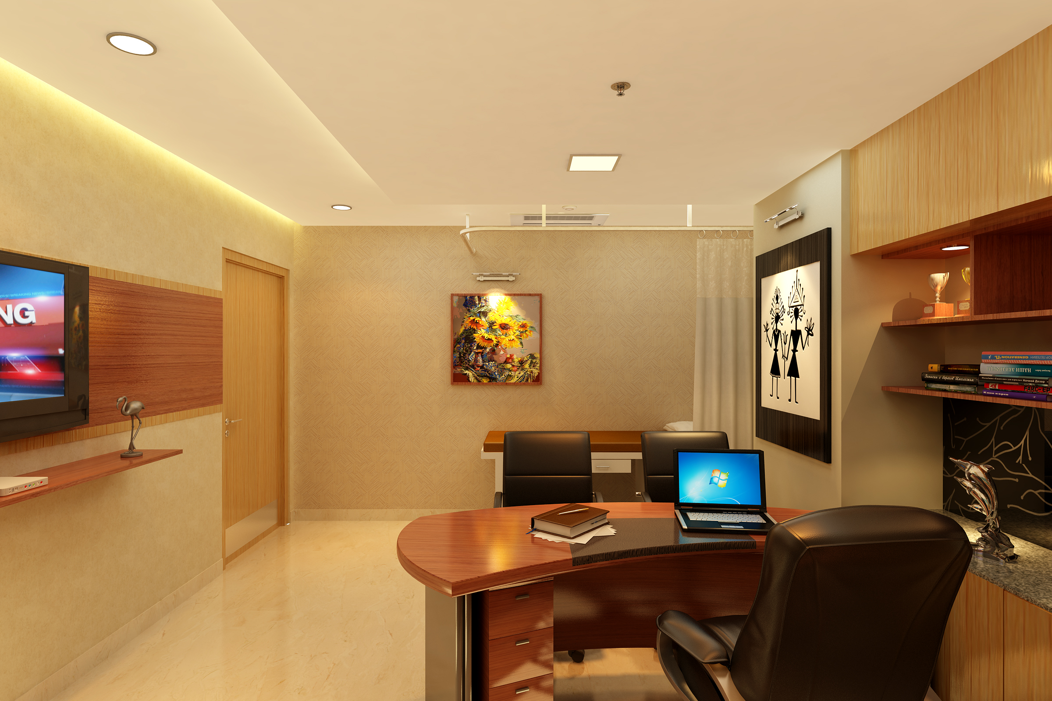
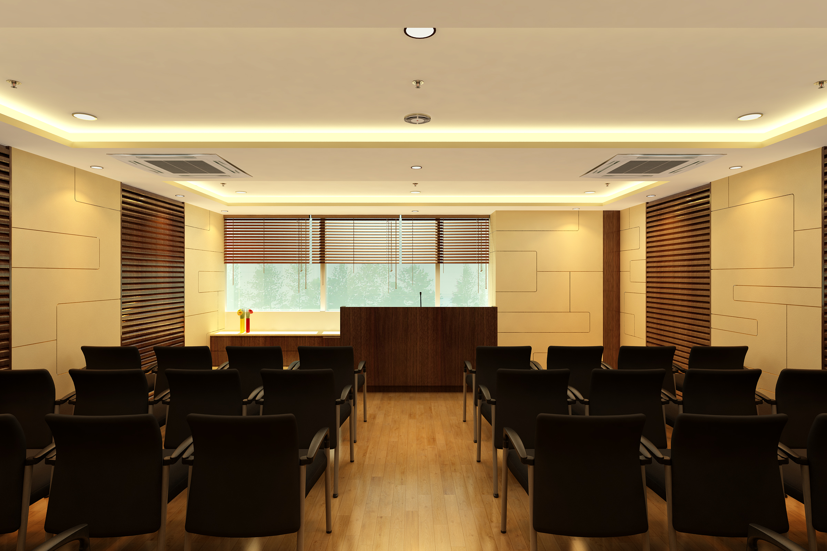
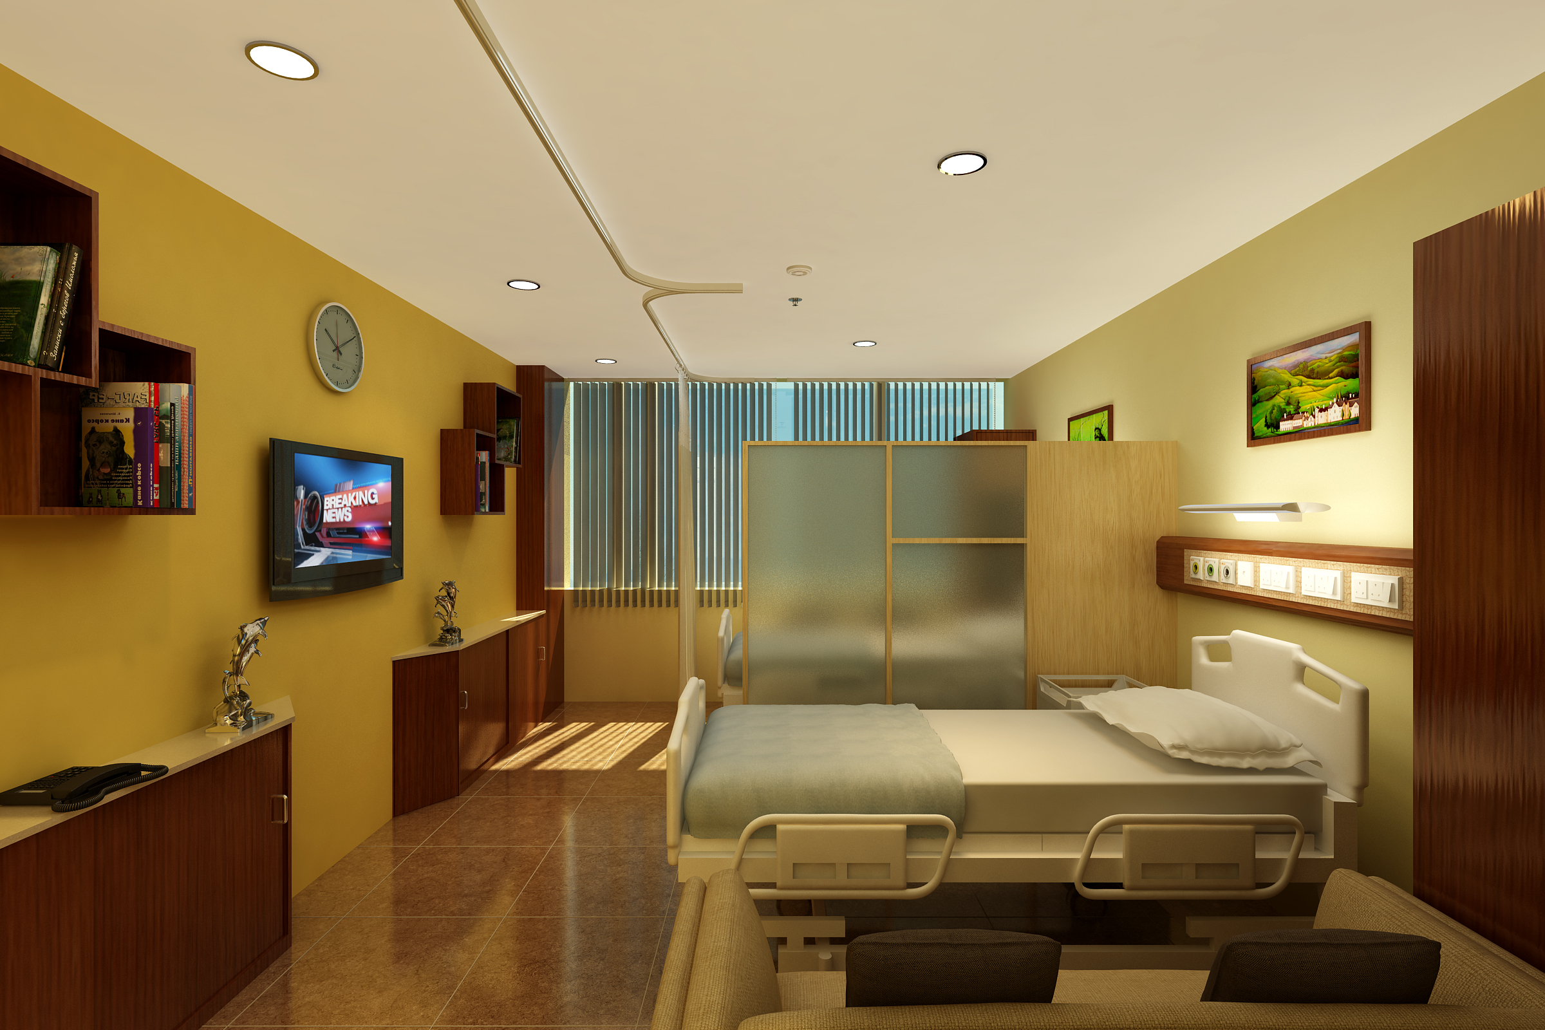
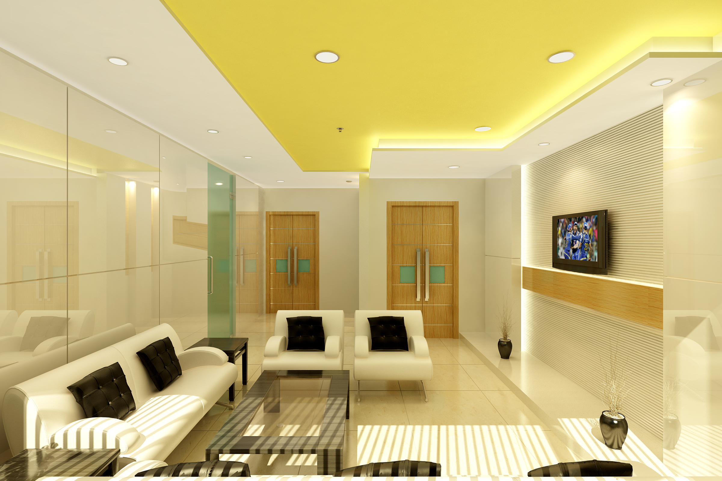
PROFESSIONAL EXPERIENCE

Slide 21
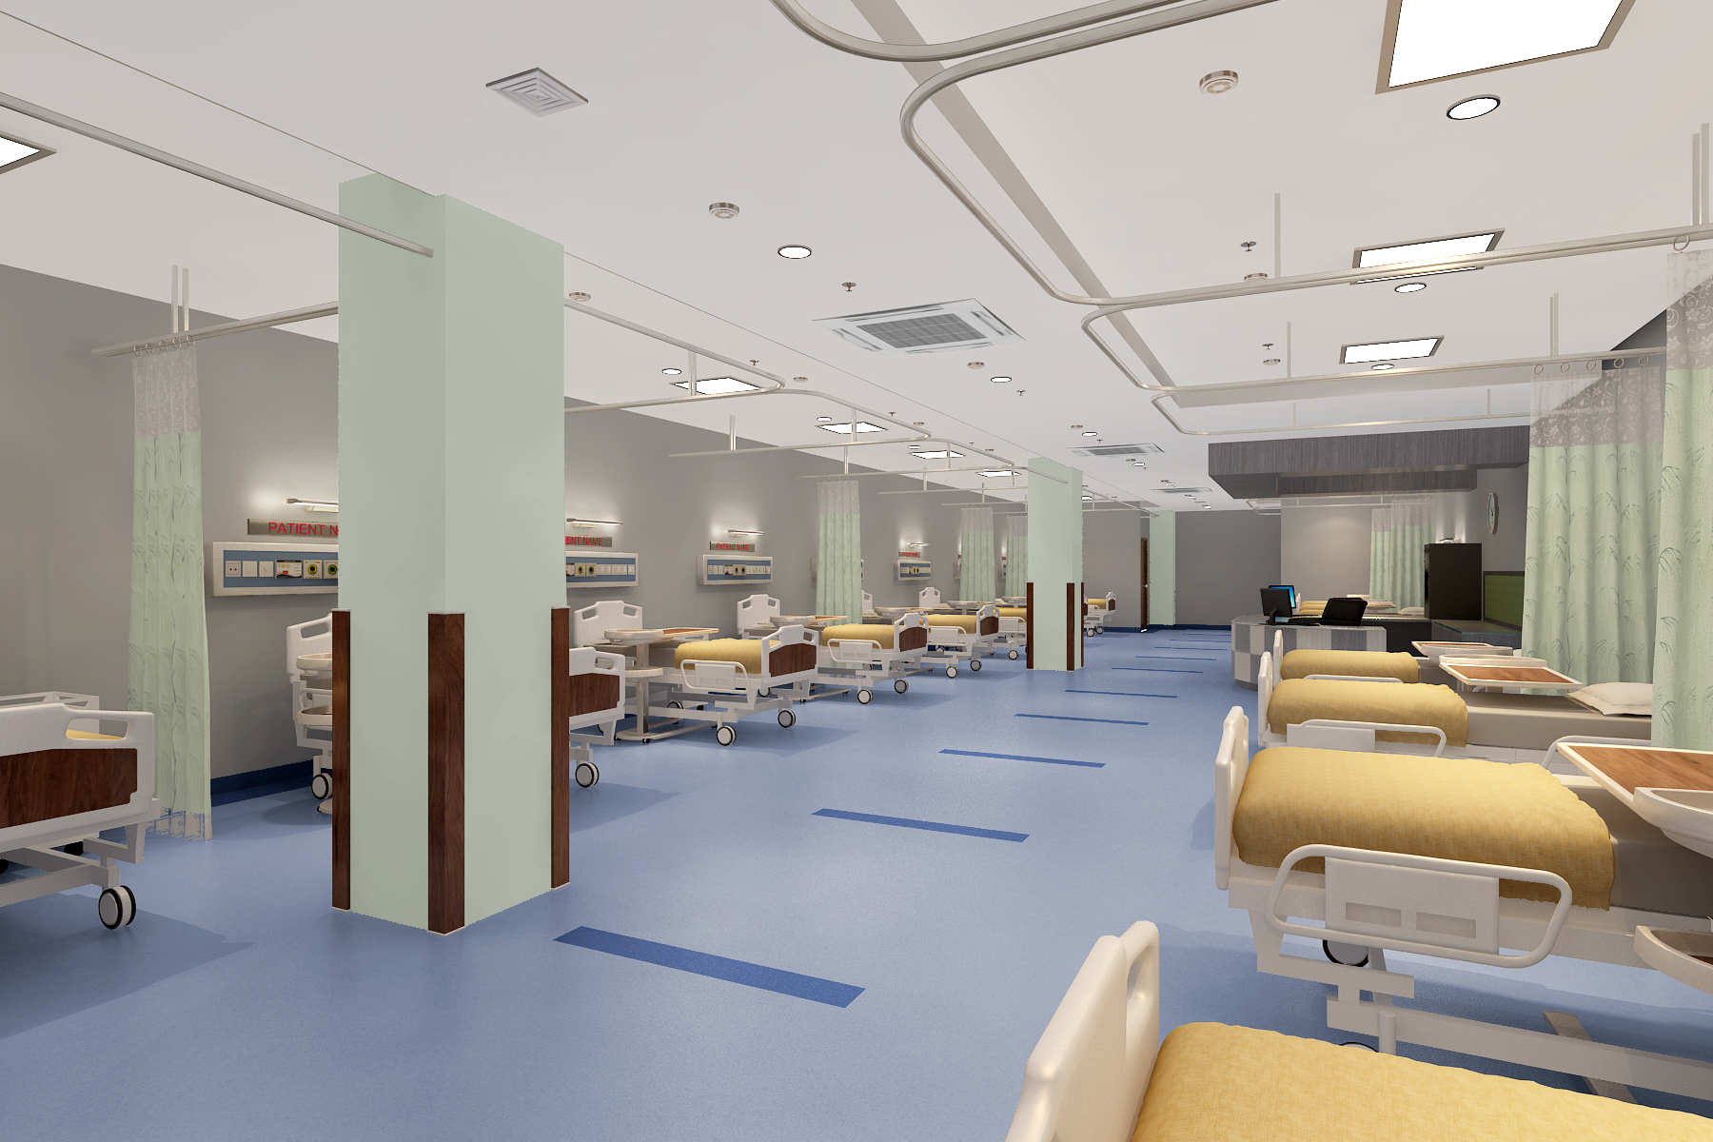
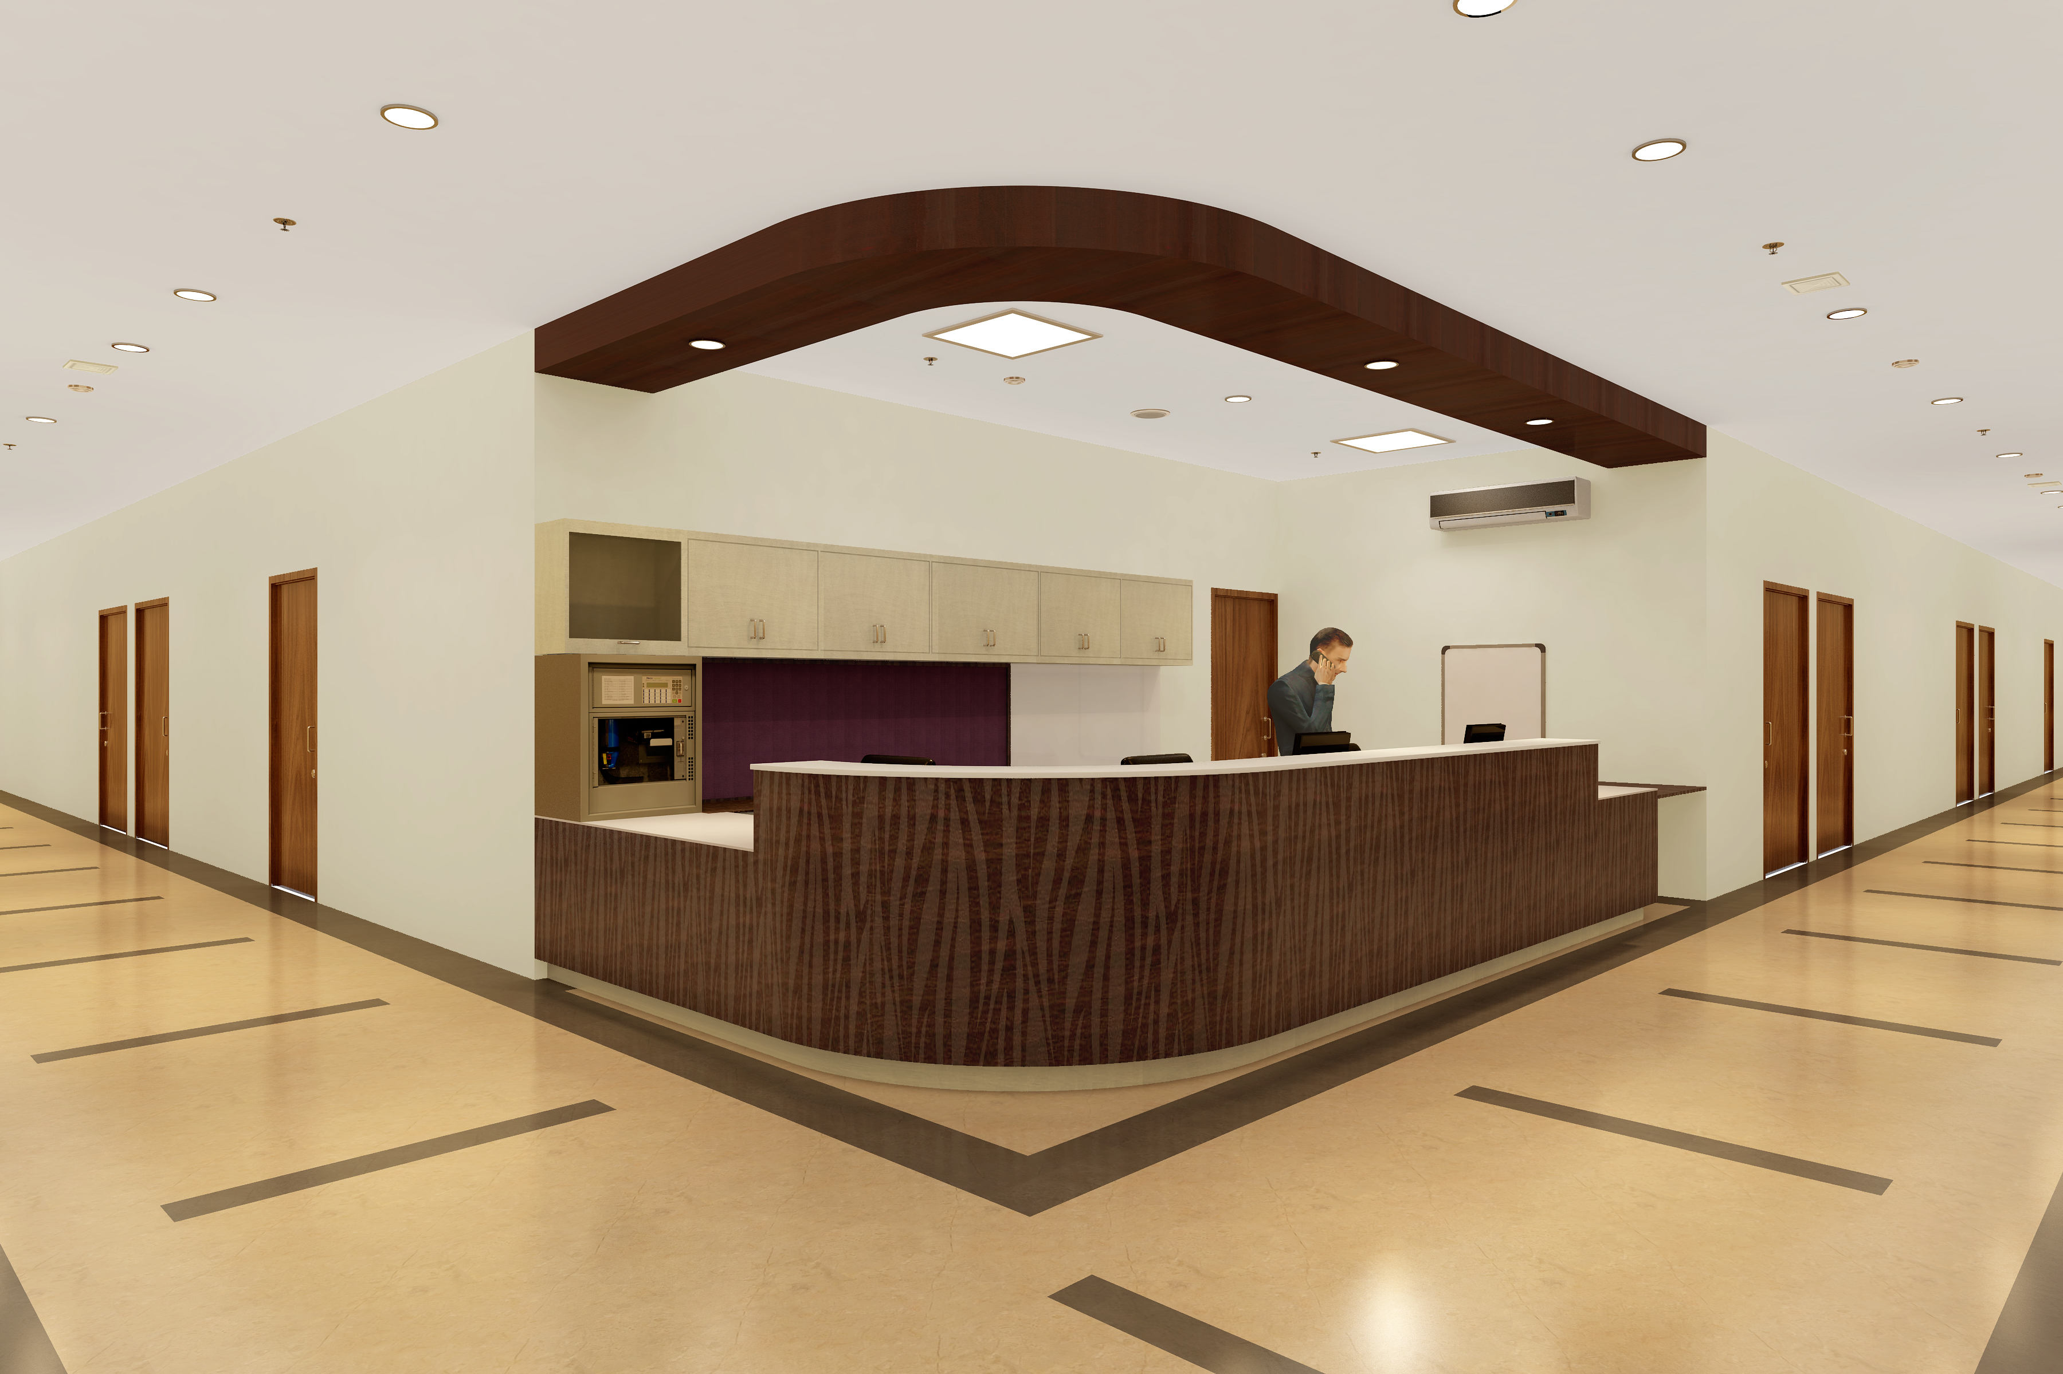
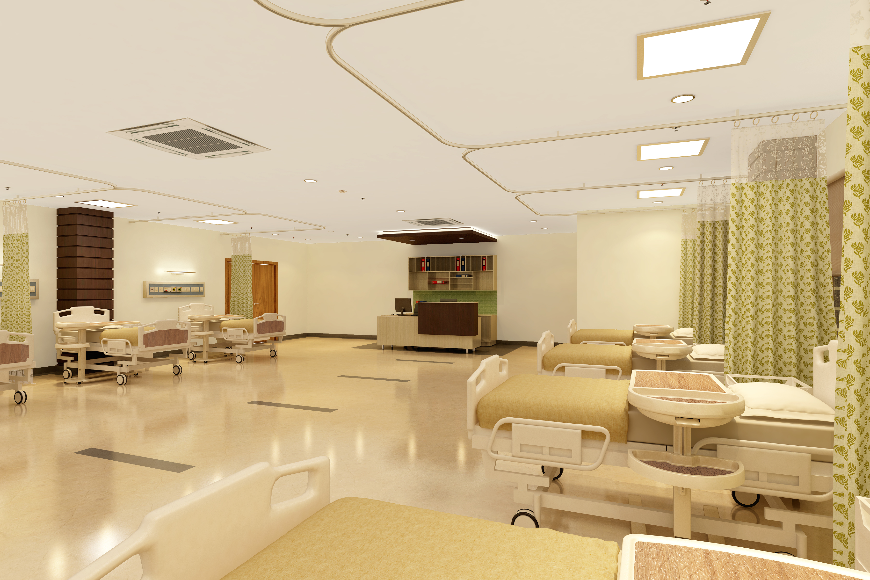
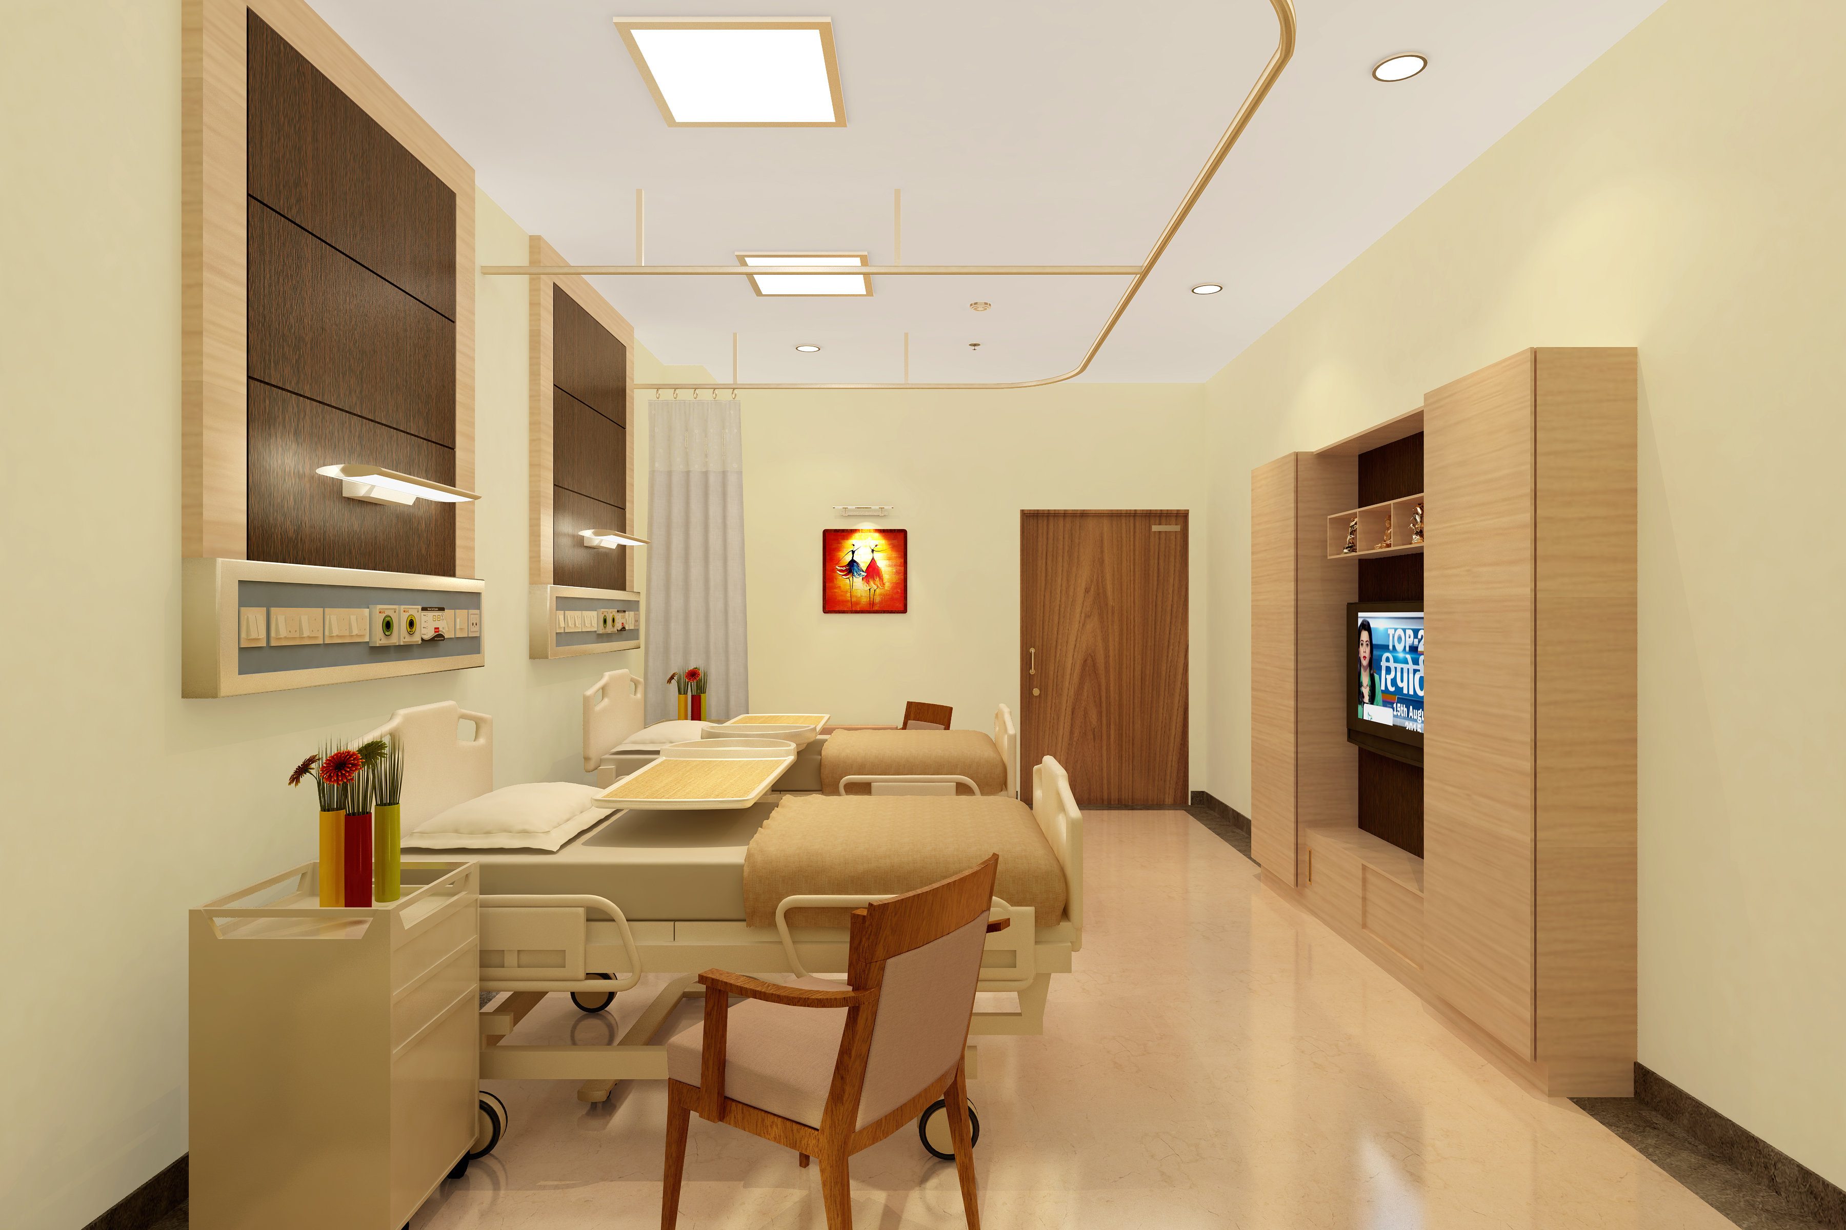
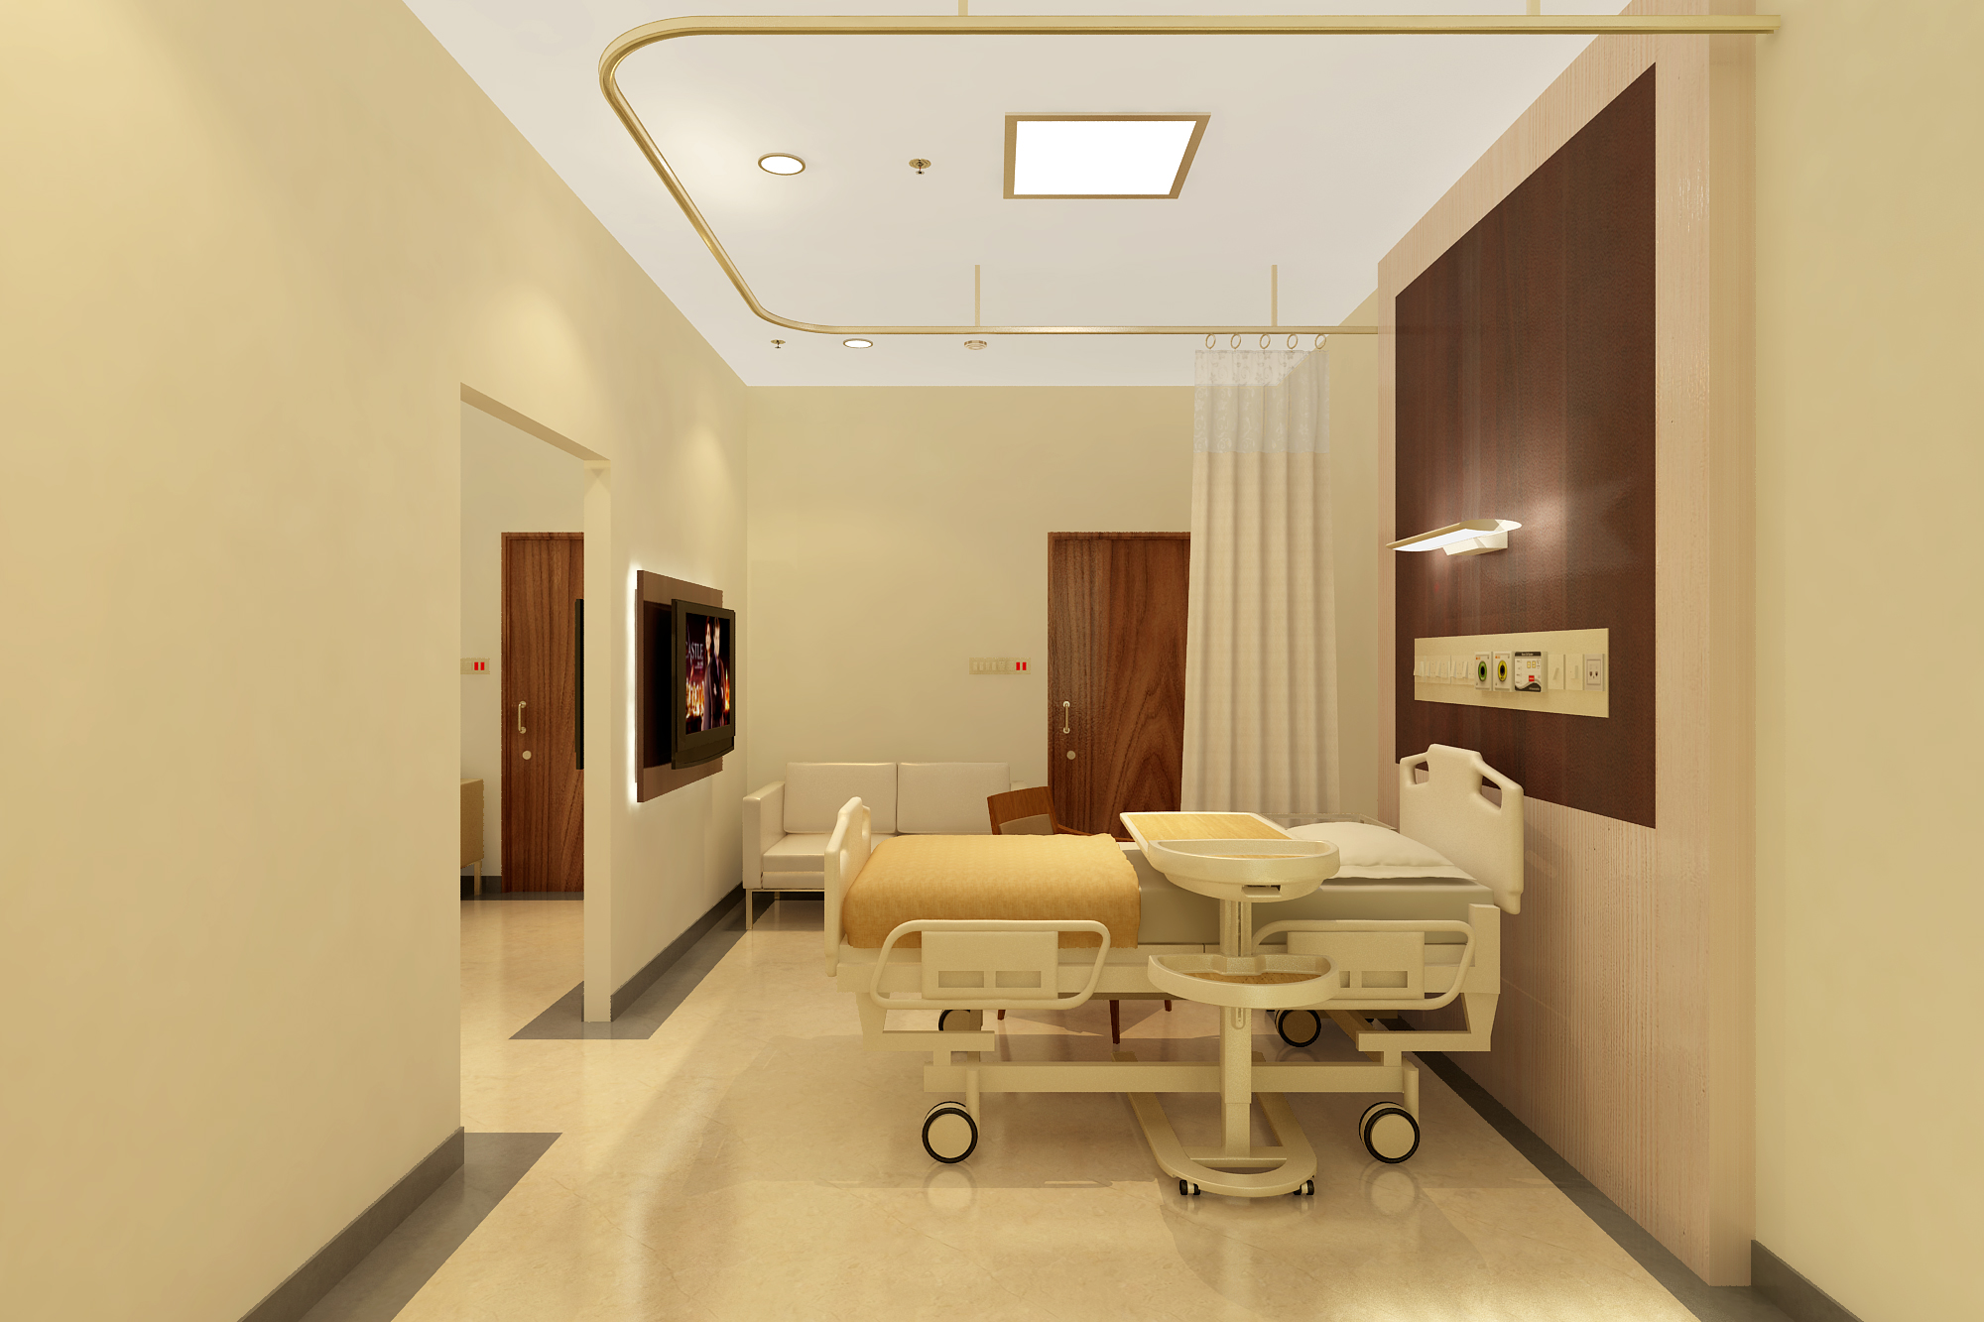
PROFESSIONAL EXPERIENCE

Slide 22
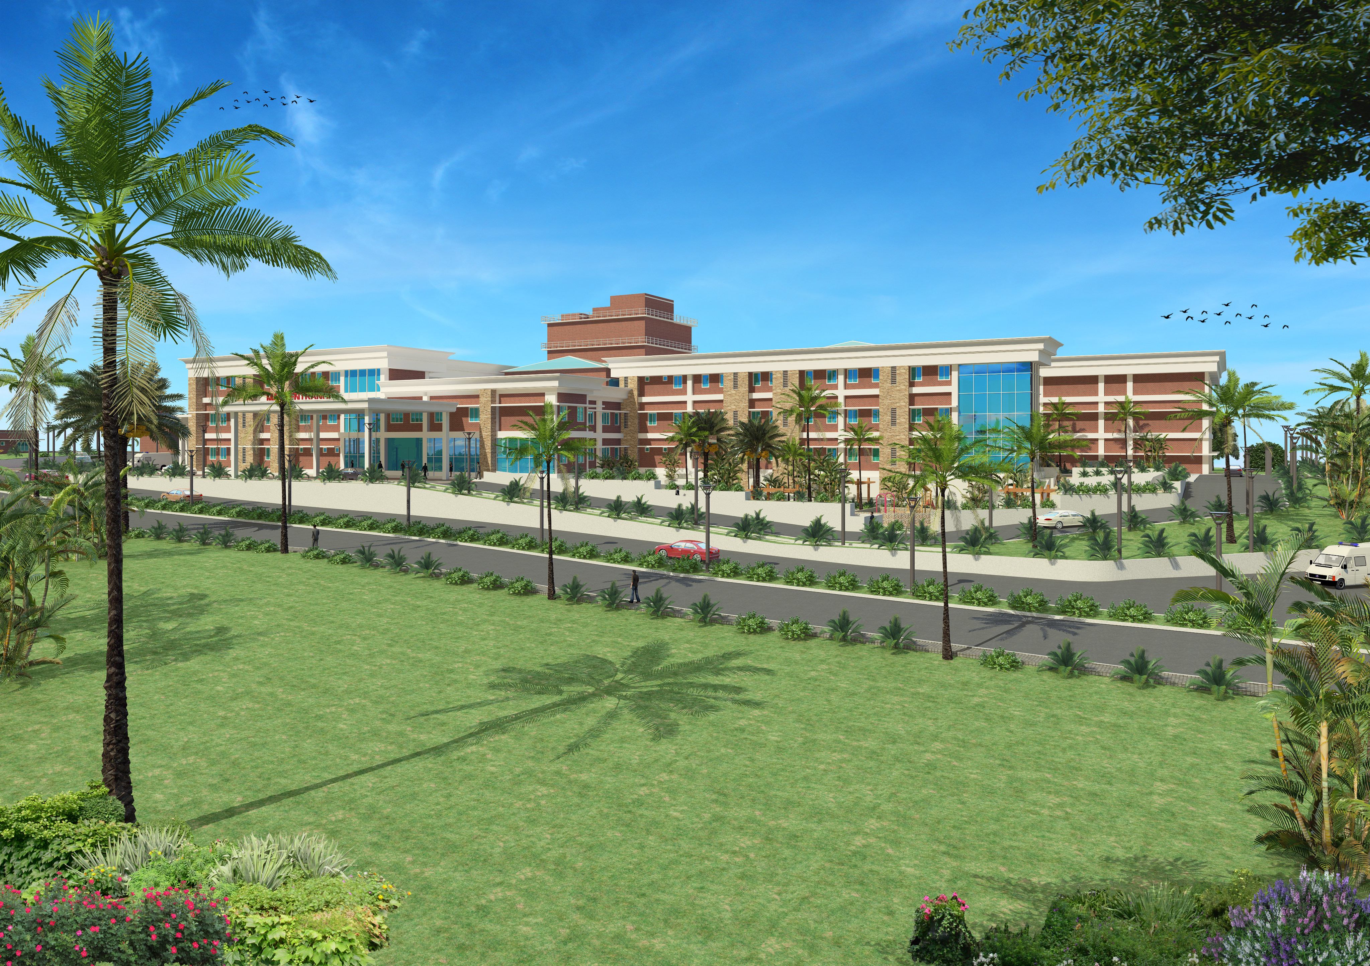
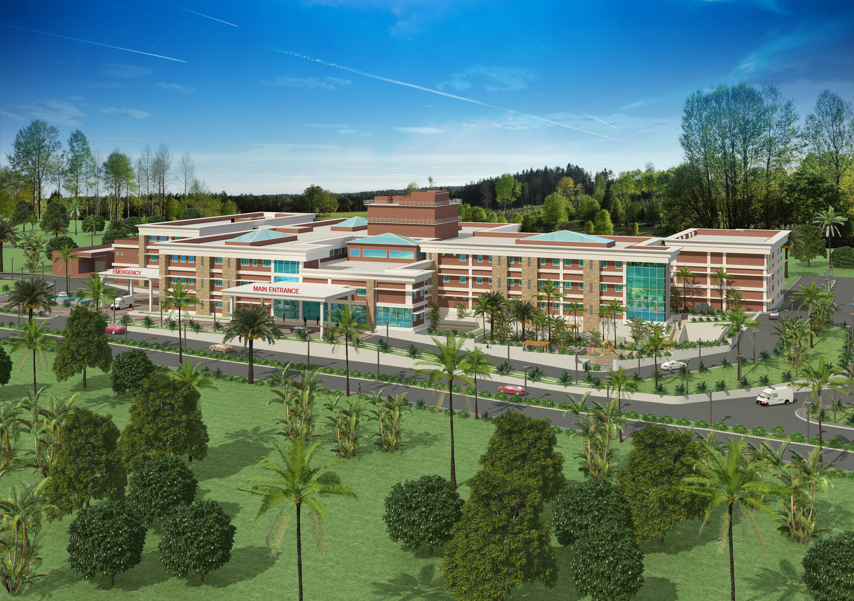
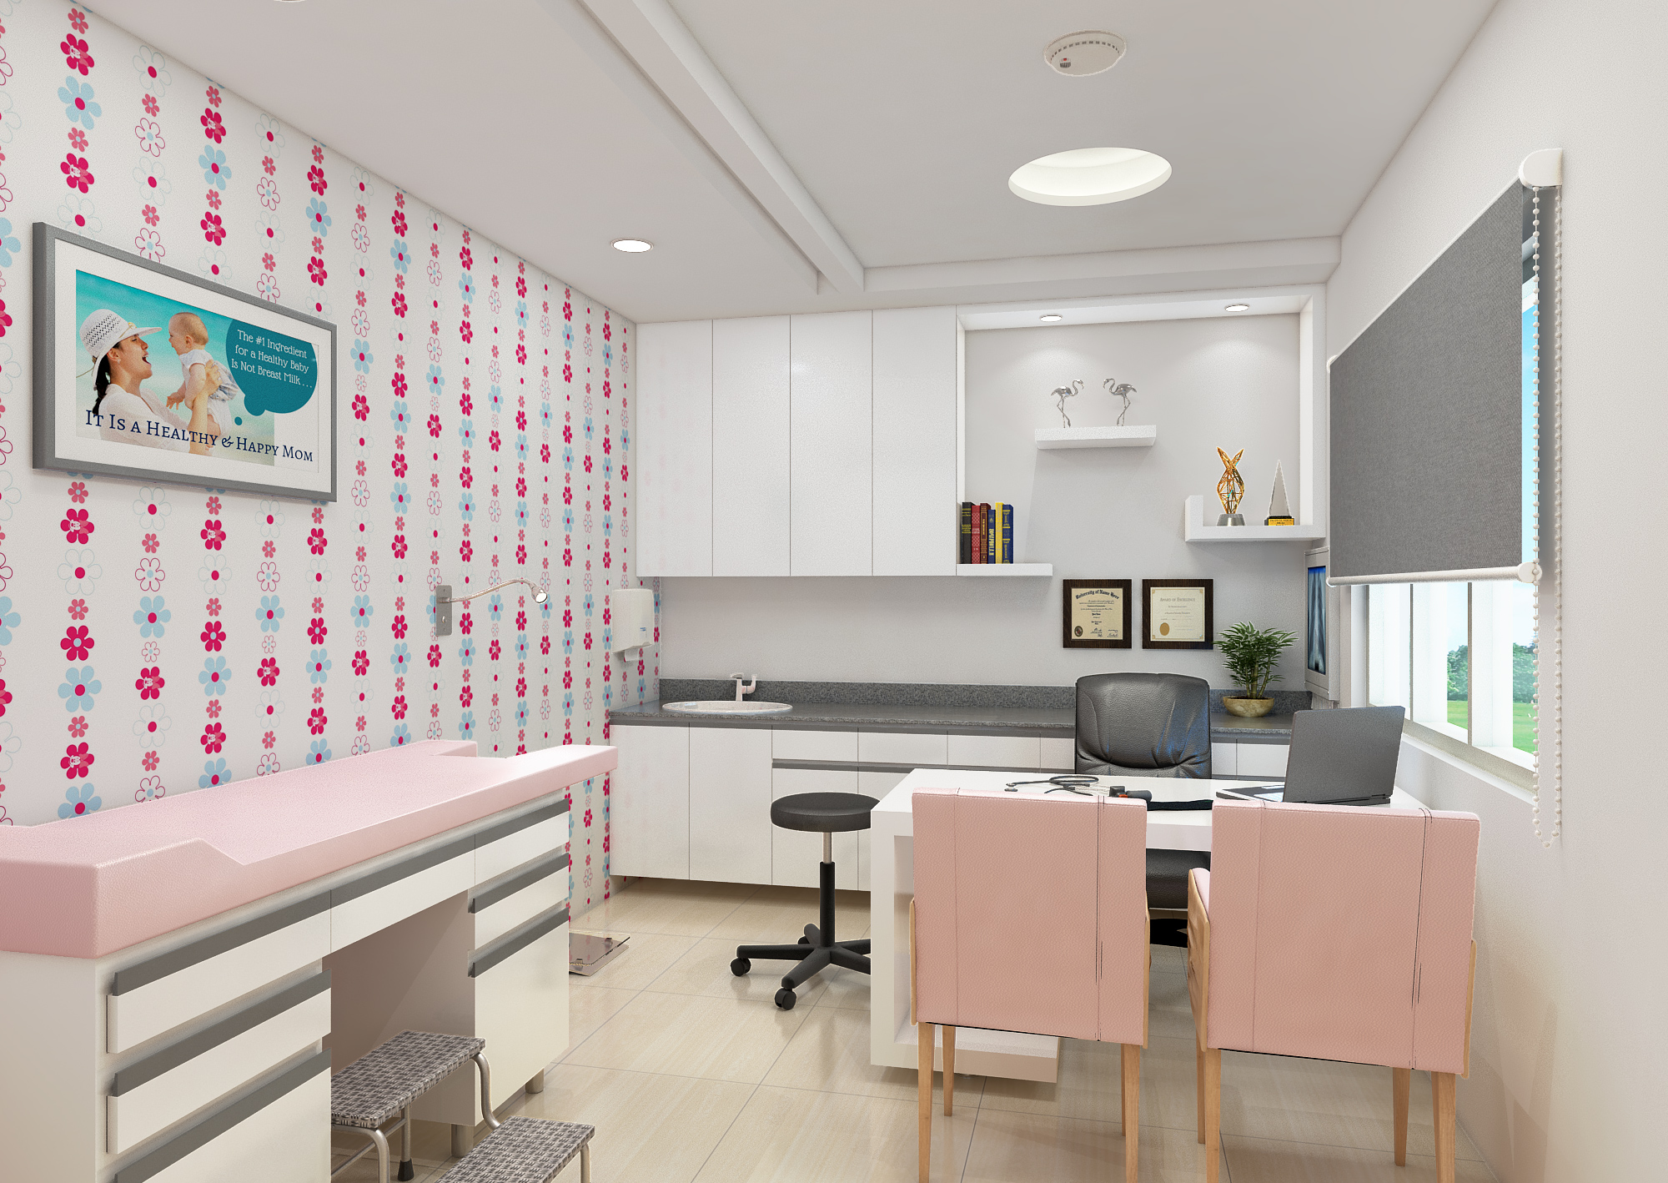
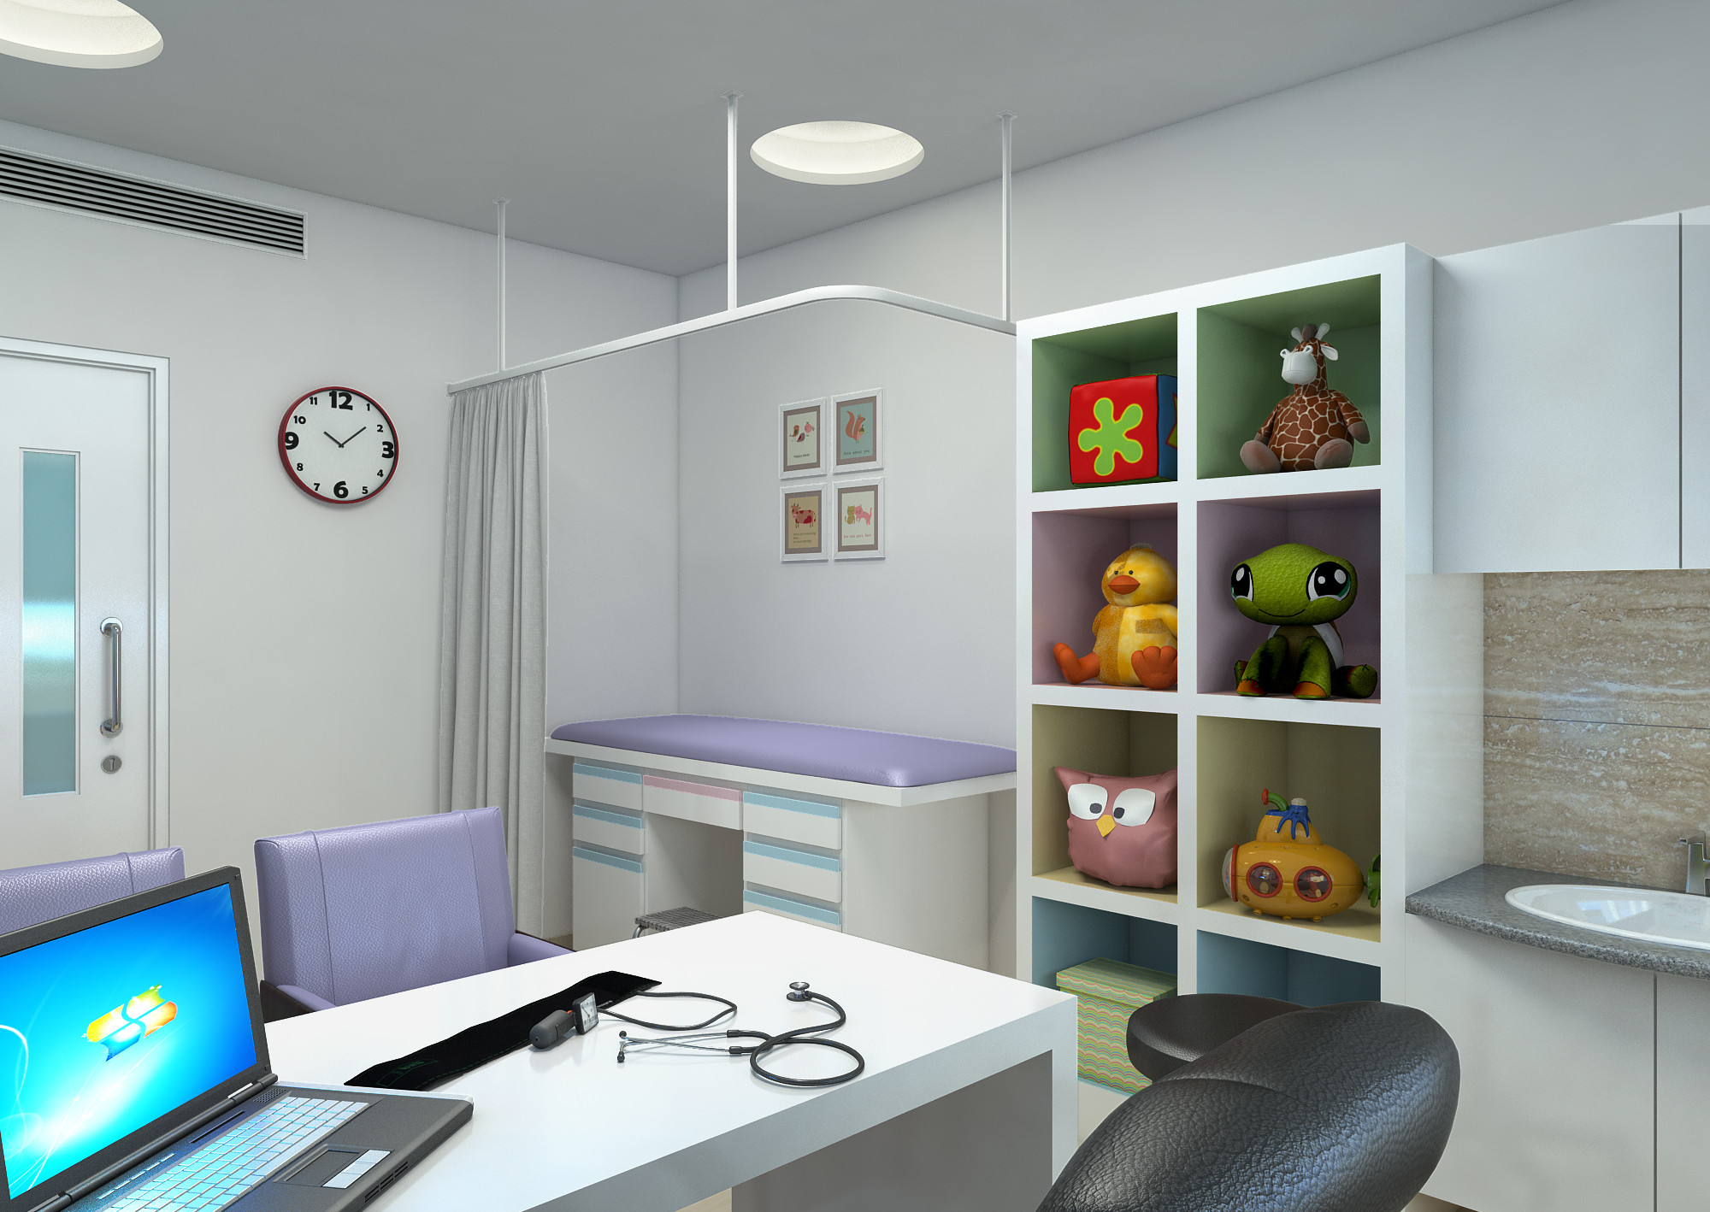
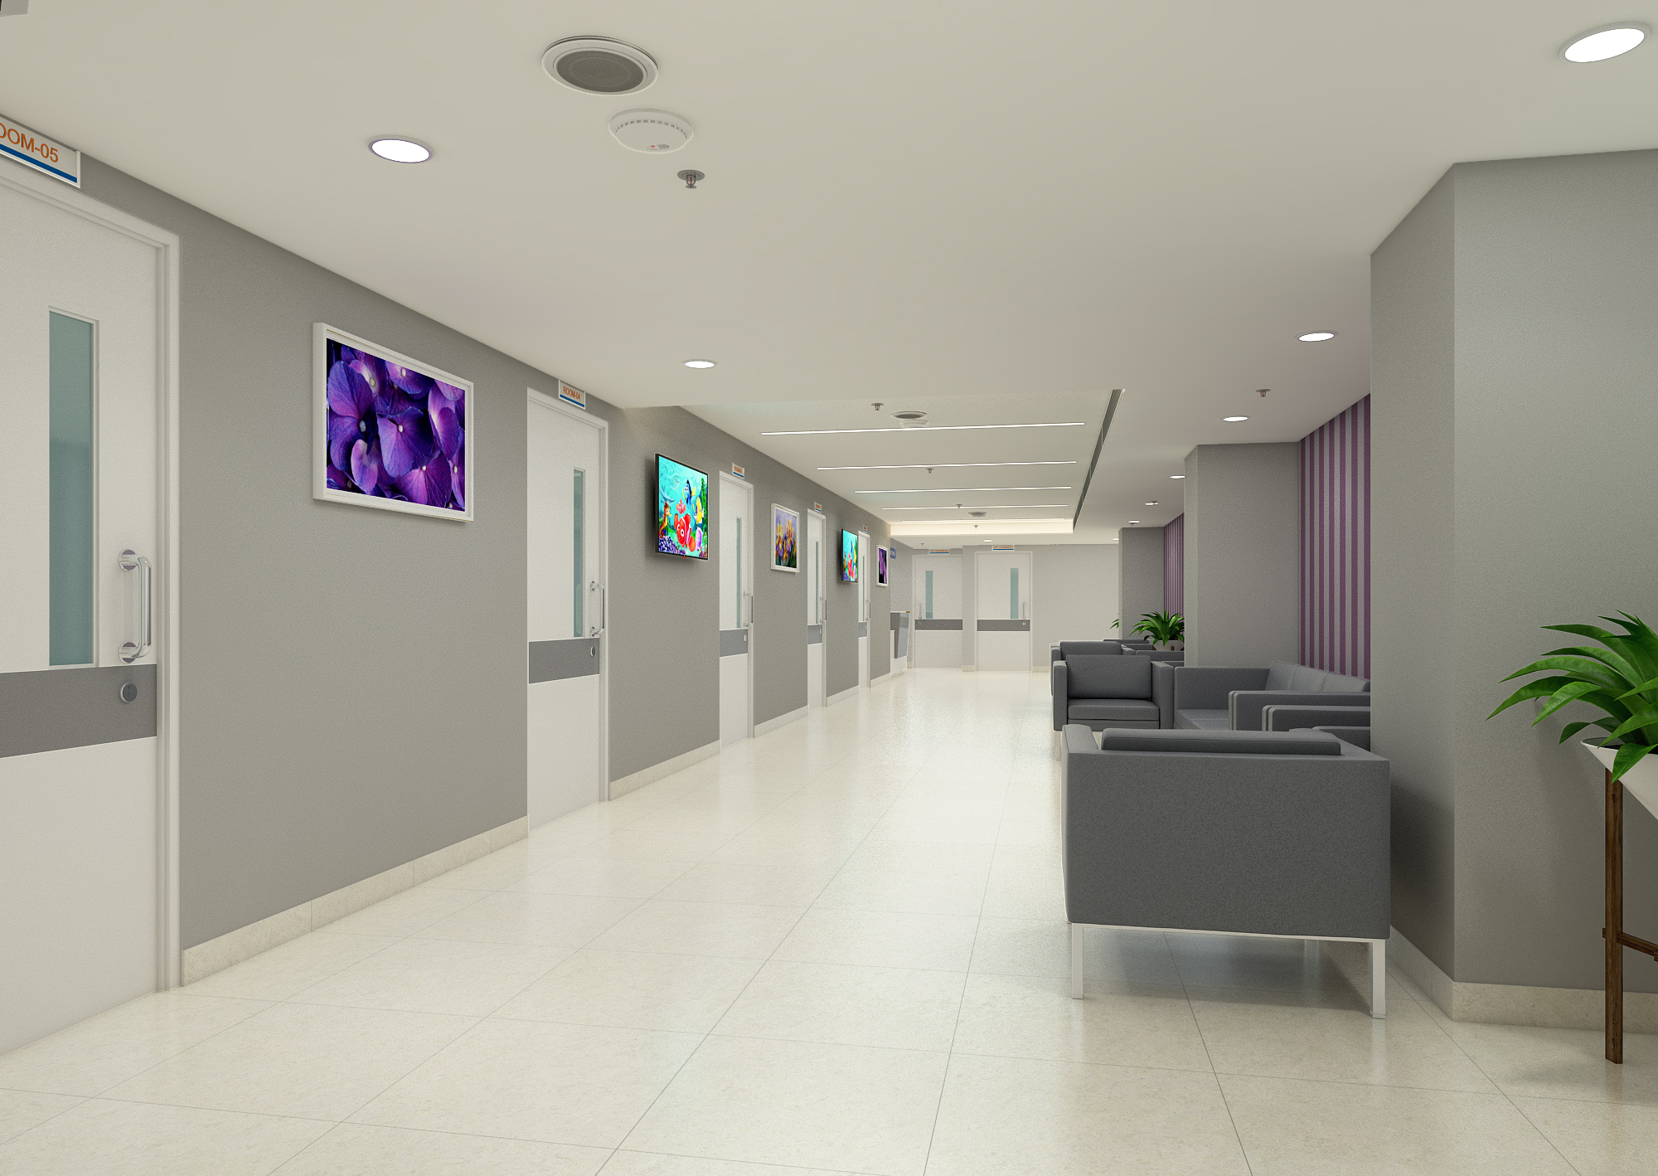
PROFESSIONAL EXPERIENCE

Slide 23
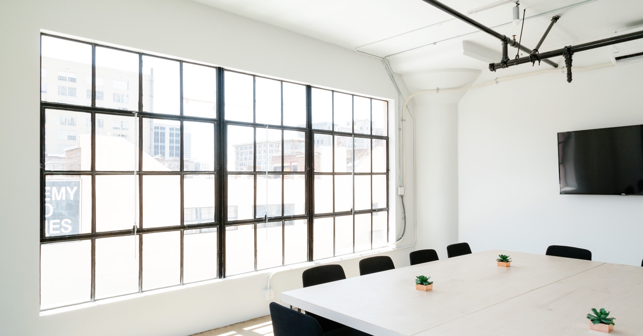
Large image
“Opportunity is everywhere. The key is to develop the vision to see it.”
Anonymous

